Slide 1
T29: UMLS Concept Identification Using the MetaMap System
AMIA Fall Symposium
Tutorial 29, Methods Series
Sunday, November 14, 2010
8:30am – 12:00pm
Alan R. Aronson, Dina Demner-Fushman,
François-Michel Lang, James G. Mork

Slide 2
Tutorial Outline
Background: why concept identification? (Lan)
Introduction to MetaMap (Lan)
The MetaMap algorithm (Lan)
Input/output formats (François, Jim)
MetaMap options in depth (Lan)
MetaMap processing modes (Lan)
Usage warnings (Lan)
Access methods (Jim)
Research projects using MetaMap (Jim, Dina)
Future directions (Lan)

Slide 3
Tutorial Outline
Background: why concept identification? (Lan)
Introduction to MetaMap (Lan)
The MetaMap algorithm (Lan)
Input/output formats (François, Jim)
MetaMap options in depth (Lan)
MetaMap processing modes (Lan)
Usage warnings (Lan)
Access methods (Jim)
Research projects using MetaMap (Jim, Dina)
Future directions (Lan)

Slide 4
Why Concept Identification?
Structured data vs. text
Concept identification is useful/essential for many tasks including
  Information extraction/Data mining
  Classification/Categorization
  Text summarization
  Question answering
  Literature-based knowledge discovery

Slide 5
Motivation for Creation of MetaMap
Our original concept identification task, Information Retrieval (IR):
  retrieval of MEDLINE records based on textual queries by
  identifying biomedical concepts occurring in both queries and MEDLINE, and
  leveraging knowledge about concepts contained in UMLS Metathesaurus

Slide 6
Tutorial Outline
Background: why concept identification? (Lan)
Introduction to MetaMap (Lan)
The MetaMap algorithm (Lan)
Input/output formats (François, Jim)
MetaMap options in depth (Lan)
MetaMap processing modes (Lan)
Usage warnings (Lan)
Access methods (Jim)
Research projects using MetaMap (Jim, Dina)
Future directions (Lan)

Slide 7
Concept Identification Programs
Selected programs that map biomedical text to a thesaurus
  SAPHIRE (Hersh et al., 1990)
  CLARIT (Evans et al., 1991)
  MetaMap (Aronson et al., 1994)
  Metaphrase (Tuttle et al., 1998)
  MMTx (2001)
  KnowledgeMap (Denny et al., 2003)
  Mgrep (Meng, 2009--unpublished)
Characteristics of MetaMap
  Linguistic rigor
  Flexible partial matching
  Emphasis on thoroughness rather than speed
  Restricted to English syntax and vocabulary

Slide 8
Example (best mappings)
PMID – 9339686
AB –Cerebral blood flow (CBF) in newborn infants is
often below levels necessary to sustain brain viability
in adults.
Cerebrovascular Circulation
Infant, Newborn
CEREBRAL BLOOD FLOW IMAGING
Frequent
Levels (qualifier value)
Sustained
Brain
Viable
Entire brain
Adult

Slide 9
Example (best mappings with WSD)
PMID – 9339686
AB –Cerebral blood flow (CBF) in newborn infants is
often below levels necessary to sustain brain viability
in adults.
Cerebrovascular Circulation
Infant, Newborn
CEREBRAL BLOOD FLOW IMAGING
Frequent
Levels (qualifier value)
Sustained
Brain
Viable
Entire brain
Adult

Slide 10
MetaMap Examples (1/7)
“inferior vena caval stent filter” maps to
  ‘Inferior Vena Cava Filter’ (‘Vena Cava Filters’) and
  ‘Stent’
“medicine” with --allow_overmatches maps to
  ‘Alternative Medicine’ or
  ‘Medical Records’ or
  ‘Nuclear medicine procedure, NOS’ or ...
“pain on the left side of the chest” with
--quick_composite_phrases maps to
  ‘Left sided chest pain’ (under development)

Slide 11
Example: Normal processing (2/7)
Phrase: “lung cancer.”
Meta Candidates (8):
1000 Lung Cancer (Malignant neoplasm of lung) [Neoplastic Process]
1000 Lung Cancer (Carcinoma of lung) [Neoplastic Process]
861 Cancer (Malignant Neoplasms) [Neoplastic Process]
861 Lung [Body Part, Organ, or Organ Component]
861 Cancer (Cancer Genus) [Invertebrate]
861 Lung (Entire lung) [Body Part, Organ, or Organ Component]
861 Cancer (Specialty Type - cancer) [Biomedical Occupation or Discipline]
768 Pneumonia [Disease or Syndrome]
Meta Mapping (1000):
1000 Lung Cancer (Carcinoma of lung) [Neoplastic Process]
Meta Mapping (1000):
1000 Lung Cancer (Malignant neoplasm of lung) [Neoplastic Process]

Slide 12
Example: Variants (-v) (3/7)
Phrase: “lung cancer.”
lung cancer [noun] variants (n=1):
lung cancer{[noun], 0=[]}
lung [noun] variants (n=9):
lung{[noun], 0=[]} lungs{[noun], 1="i"} pneumonia{[noun], 5="ds"} pneumoniae{[noun], 5="ds"} pneumonias{[noun], 5="ds"} pneumonic{[adj], 2="s"} pulmonal{[adj], 4="ss"} pulmonary{[adj], 2="s"} pulmonic{[adj], 2="s"}
cancer [noun] variants (n=4):
cancer{[noun], 0=[]} cancerous{[adj], 3="d"} cancers{[noun], 1="i"} carcinomatous{[adj], 2="s"}
...

Slide 13
Example: Compound mappings (4/7)
Phrase: “obstructive sleep apnea.”
Meta Candidates (8):
...
Meta Mapping (1000):
1000 Obstructive sleep apnoea (Sleep Apnea, Obstructive) [Disease or Syndrome]
Meta Mapping (901):
827 Obstructive (Obstructed) [Functional Concept]
901 Apnea, Sleep (Sleep Apnea Syndromes) [Disease or Syndrome]
Meta Mapping (851):
827 Obstructive (Obstructed) [Functional Concept]
827 Sleep [Organism Function]
827 APNOEA (Apnea) [Pathologic Function]
…
with
--compute_all_mappings

Slide 14
Example: Show sources (-G) (5/7)
Phrase: “scorpion sting.“
Meta Candidates (4):
1000 Scorpion sting {MDR,DXP} [Injury or Poisoning]
861 Sting (Sting Injury {MTH,MSH,MDR,RCD,SNM,SNOMEDCT,SNMI,WHO}) [Injury or Poisoning]
694 Scorpion (Scorpions {LCH,MSH,MTH,SNM,SNOMEDCT,SNMI,CSP,
RCD,NCBI}) [Invertebrate]
694 SCORPION (Scorpion antigen {MTH,LNC}) [Immunologic Factor]
Meta Mapping (1000):
1000 Scorpion sting {MDR,DXP} [Injury or Poisoning]

Slide 15
Example: Restrict to sources (-GR LCH) (6/7)
Phrase: “scorpion sting.”
Meta Candidates (1):
694 Scorpion (Scorpions {LCH}) [Invertebrate]
Meta Mapping (694):
694 Scorpion (Scorpions {LCH}) [Invertebrate]

Slide 16
Example: Restrict to STs (-J neop) (7/7)
Phrase: “lung cancer.”
Meta Candidates (3):
1000 Lung Cancer (Malignant neoplasm of lung) [Neoplastic Process]
1000 Lung Cancer (Carcinoma of lung) [Neoplastic Process]
861 Cancer (Malignant Neoplasms) [Neoplastic Process]
Meta Mapping (1000):
1000 Lung Cancer (Carcinoma of lung) [Neoplastic Process]
Meta Mapping (1000):
1000 Lung Cancer (Malignant neoplasm of lung) [Neoplastic Process]

Slide 17
MetaMap Demo
http://skr.nlm.nih.gov

Slide 18
Tutorial Outline
Background: why concept identification? (Lan)
Introduction to MetaMap (Lan)
The MetaMap algorithm (Lan)
Input/output formats (François, Jim)
MetaMap options in depth (Lan)
MetaMap processing modes (Lan)
Usage warnings (Lan)
Access methods (Jim)
Research projects using MetaMap (Jim, Dina)
Future directions (Lan)

Slide 19
The Algorithm
Parsing
  Using SPECIALIST minimal commitment parser, SPECIALIST lexicon, MedPost part of speech tagger
Variant generation
  Using SPECIALIST lexicon, Lexical Variant Generation (LVG)
Candidate retrieval
  From the Metathesaurus
Candidate evaluation
Mapping construction

Slide 20
Parsing
Text
  Ocular complications of myasthenia gravis.
Tagging
  Ocular complications of myasthenia gravis .
  adj/2 noun prep noun noun/2 pd
Simplified phrases
  [mod(ocular), head(complications)]
  [prep(of), head(myasthenia gravis), punc(.)]

Slide 21
Variant Generation
Variants of adjective ocular (13, 9 occur in UMLS):
  ocular{[adj], 0=[]}
  eye{[noun], 2="s"}
  eyes{[noun], 3="si"}
  optic{[adj], 4="ss"}
  ophthalmic{[adj], 4="ss"}
  ophthalmia{[noun], 7="ssd"}
  ophthalmias{[noun], 8="ssdi"}
  ophthalmiac{[noun], 7="ssd"}
  ophthalmiacs{[noun], 8="ssdi"}
  oculus{[noun], 3="d"}
  oculi{[noun], 4="di"}
  ocularity{[noun], 3="d"}
  ocularities{[noun], 4="di"}
Notes:
blue actually occur in the Metathesaurus

Slide 22
Evaluation Function
Weighted average of
  centrality (is the head involved?)
  variation (average of all individual word variations)
  coverage (how much of the text is matched?)
  cohesiveness (in how many pieces?)
Notes:
Weights: 1 1 2 2
For browse mode, involvement replaces coverage and cohesiveness with weights 1 1 4

Slide 23
Evaluation Results
Phrase: Ocular complications
Meta Candidates (8):
  861 Complications (Complication) [patf]
  861 complications (Complication Aspects) [patf]
  777 Complicated [ftcn]
  694 Ocular (Eye) [bpoc]
  638 Eye (Entire Eye) [bpoc]
  611 Optic (Optics) [ocdi]
  611 Ophthalmic [spco]
  588 Ophthalmia (Endophthalmitis) [dsyn]

Slide 24
Mapping Construction
Phrase: Ocular complications
Meta Mapping (888):
  Ocular (Eye) [bpoc]
  Complications (Complication) [patf]
Meta Mapping (888):
  Ocular (Eye) [bpoc]
  complications (Complication Aspects) [patf]

Slide 25
Mapping Construction (with WSD)
Phrase: Ocular complications
Meta Mapping (888):
  Ocular (Eye) [bpoc]
  Complications (Complication) [patf]
Meta Mapping (888):
  Ocular (Eye) [bpoc]
  complications (Complication Aspects) [patf]

Slide 26
Tutorial Outline
Background: why concept identification? (Lan)
Introduction to MetaMap (Lan)
The MetaMap algorithm (Lan)
Input/output formats (François, Jim)
MetaMap options in depth (Lan)
MetaMap processing modes (Lan)
Usage warnings (Lan)
Access methods (Jim)
Research projects using MetaMap (Jim, Dina)
Future directions (Lan)

Slide 27
Input Formats
ASCII only input
Unformatted English free text
MEDLINE Citations
Input records delimited by blank line
Single-line delimited input (via job Scheduler)
heart attack
lung cancer
Single-line delimited input with ID (Scheduler)
000001|heart attack
000002|lung cancer
Notes:
Jim will discuss the Job Scheduler later, but it’s a workstation farm that allows rapid batch processing of large amounts of text.

Slide 28
Input Should Have Syntactic Structure
Lack of structure → long phrases
→ combinatorial explosion in mappings
  protein-4 FN3 fibronectin type III domain GSH lutathione GST glutathione S-transferase hIL-6 human interleukin-6 HSA human serum albumin IC(50) half-maximal inhibitory concentration Ig immunoglobulin IMAC immobilized metal affinity chromatography K(D) equilibrium constant
  from filamentous bacteriophage f1 PCR polymerase-chain reaction PDB Protein Data Bank PSTI human pancreatic secretory trypsin inhibitor RBP retinol-binding protein SPR surface plasmon resonance TrxA

Slide 29
Input Format Syntax Limitation
Phrase length is negligible constraint in MEDLINE:
  μ = 1.31
  σ = 1.18
99.9% of MEDLINE phrases ≤ 8 tokens
--phrases_only MetaMap option

Slide 30
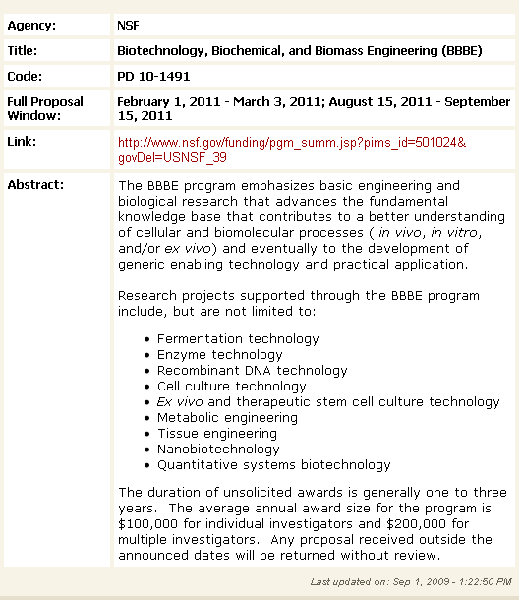
Be careful of
bulleted lists!

Slide 31
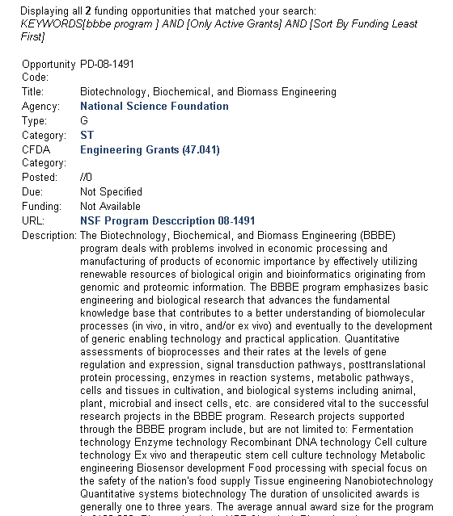
Same text…
w/o bullets!

Slide 32
Output Formats: Summary
Human-readable output
MetaMap Machine Output (MMO)
XML output
Colorized MetaMap output (MetaMap 3D)
Fielded (MMI) Output

Slide 33
Output Formats: Human Readable
Phrase: "heart attack"
Meta Candidates (8):
1000 Heart attack (Myocardial Infarction) [Disease or Syndrome]
861 Heart [Body Part, Organ, or Organ Component]
861 Attack, NOS (Onset of illness) [Finding]
861 Attack (Attack device) [Medical Device]
861 attack (Attack behavior) [Social Behavior]
861 Heart (Entire heart) [Body Part, Organ, or Organ Component]
861 Attack (Observation of attack) [Finding]
827 Attacked (Assault) [Injury or Poisoning]
Meta Mapping (1000):
1000 Heart attack (Myocardial Infarction) [Disease or Syndrome]
Notes:
Next, let’s look at the various components of human-readable output.

Slide 34
Human Readable: Metathesaurus String
Phrase: "heart attack"
Meta Candidates (8):
1000 Heart attack (Myocardial Infarction) [Disease or Syndrome]
861 Heart [Body Part, Organ, or Organ Component]
861 Attack, NOS (Onset of illness) [Finding]
861 Attack (Attack device) [Medical Device]
861 attack (Attack behavior) [Social Behavior]
861 Heart (Entire heart) [Body Part, Organ, or Organ Component]
861 Attack (Observation of attack) [Finding]
827 Attacked (Assault) [Injury or Poisoning]
Meta Mapping (1000):
1000 Heart attack (Myocardial Infarction) [Disease or Syndrome]

Slide 35
Human Readable: Preferred Name
Phrase: "heart attack"
Meta Candidates (8):
1000 Heart attack (Myocardial Infarction) [Disease or Syndrome]
861 Heart [Body Part, Organ, or Organ Component]
861 Attack, NOS (Onset of illness) [Finding]
861 Attack (Attack device) [Medical Device]
861 attack (Attack behavior) [Social Behavior]
861 Heart (Entire heart) [Body Part, Organ, or Organ Component]
861 Attack (Observation of attack) [Finding]
827 Attacked (Assault) [Injury or Poisoning]
Meta Mapping (1000):
1000 Heart attack (Myocardial Infarction) [Disease or Syndrome]

Slide 36
Human Readable: MetaMap Scores
Phrase: "heart attack"
Meta Candidates (8):
1000 Heart attack (Myocardial Infarction) [Disease or Syndrome]
861 Heart [Body Part, Organ, or Organ Component]
861 Attack, NOS (Onset of illness) [Finding]
861 Attack (Attack device) [Medical Device]
861 attack (Attack behavior) [Social Behavior]
861 Heart (Entire heart) [Body Part, Organ, or Organ Component]
861 Attack (Observation of attack) [Finding]
827 Attacked (Assault) [Injury or Poisoning]
Meta Mapping (1000):
1000 Heart attack (Myocardial Infarction) [Disease or Syndrome]

Slide 37
Human Readable: Semantic Types
Phrase: "heart attack"
Meta Candidates (8):
1000 Heart attack (Myocardial Infarction) [Disease or Syndrome]
861 Heart [Body Part, Organ, or Organ Component]
861 Attack, NOS (Onset of illness) [Finding]
861 Attack (Attack device) [Medical Device]
861 attack (Attack behavior) [Social Behavior]
861 Heart (Entire heart) [Body Part, Organ, or Organ Component]
861 Attack (Observation of attack) [Finding]
827 Attacked (Assault) [Injury or Poisoning]
Meta Mapping (1000):
1000 Heart attack (Myocardial Infarction) [Disease or Syndrome]
Notes:
There are many variations available for human-readable output.
Let’s look at a few.
Suppose you don’t want to see Semantic Types.

Slide 38
Human Readable: w/o SemTypes (-s)
Phrase: "heart attack"
Meta Candidates (8):
1000 Heart attack (Myocardial Infarction)
861 Heart
861 Attack, NOS (Onset of illness)
861 Attack (Attack device)
861 attack (Attack behavior)
861 Heart (Entire heart)
861 Attack (Observation of attack)
827 Attacked (Assault)
Meta Mapping (1000):
1000 Heart attack (Myocardial Infarction)
Notes:
Suppose you want to see CUIs for each concept.

Slide 39
Human Readable with CUIs (-I)
Meta Candidates (8):
1000 C0027051:Heart attack (Myocardial Infarction) [Disease or Syndrome]
861 C0018787:Heart [Body Part, Organ, or Organ Component]
861 C0277793:Attack, NOS (Onset of illness) [Finding]
861 C0699795:Attack (Attack device) [Medical Device]
861 C1261512:attack (Attack behavior) [Social Behavior]
861 C1281570:Heart (Entire heart) [Body Part, Organ, or Organ Component]
861 C1304680:Attack (Observation of attack) [Finding]
827 C0004063:Attacked (Assault) [Injury or Poisoning]
Meta Mapping (1000):
1000 C0027051:Heart attack (Myocardial Infarction) [Disease or Syndrome]
Notes:
Suppose you want to see the Metathesaurus sources from which each concept is taken.

Slide 40
Human Readable with Sources (-G)
Meta Candidates (8):
1000 Heart attack (Myocardial Infarction {MEDLINEPLUS}) [Disease or Syndrome]
861 Heart {AIR, BI, PNDS} [Body Part, Organ, or Organ Component]
861 Attack, NOS (Onset of illness {MTH, SNOMEDCT, AOD}) [Finding]
861 Attack (Attack device {MTH, MMSL}) [Medical Device]
861 attack (Attack behavior {MTH, PSY, AOD}) [Social Behavior]
861 Heart (Entire heart {MTH, SNOMEDCT}) [Body Part, Organ, or Organ Component]
861 Attack (Observation of attack {MTH, SNOMEDCT}) [Finding]
827 Attacked (Assault {ICD10AM,ICPC2P}) [Injury or Poisoning]
Meta Mapping (1000):
1000 Heart attack (Myocardial Infarction {MEDLINEPLUS}) [Disease or Syndrome]
Notes:
That’s a whirlwind tour of some of the variations of human-readable output.
Now let’s go back to the plain-vanilla human-readable output, which we saw earlier,
as a way of introducing the next kind of output.

Slide 41
Output Formats: Human Readable
Phrase: "heart attack"
Meta Candidates (8):
1000 Heart attack (Myocardial Infarction) [Disease or Syndrome]
861 Heart [Body Part, Organ, or Organ Component]
861 Attack, NOS (Onset of illness) [Finding]
861 Attack (Attack device) [Medical Device]
861 attack (Attack behavior) [Social Behavior]
861 Heart (Entire heart) [Body Part, Organ, or Organ Component]
861 Attack (Observation of attack) [Finding]
827 Attacked (Assault) [Injury or Poisoning]
Meta Mapping (1000):
1000 Heart attack (Myocardial Infarction) [Disease or Syndrome]
Notes:
We will show MetaMap Machine Output for just the candidate list,
otherwise it wouldn’t fit on the slide.

Slide 42
Output Formats: Machine Output
Prolog terms (pretty-printed & condensed!)
candidates([
ev(-1000, 'C0027051', 'Heart attack', 'Myocardial Infarction', [heart,attack],
[dsyn], [[[1,2],[1,2],0]], yes, no, ['MEDLINEPLUS], [0/12]),
ev(-861, 'C0018787', 'Heart', 'Heart', [heart],
[bpoc], [[[1,1],[1,1],0]], yes, no, ['AIR'],[0/5]),
ev(-861, 'C0277793', 'Attack, NOS', 'Onset of illness', [attack],
[fndg], [[[2,2],[1,1],0]], yes, no, ['MTH'], [6/6]),
ev(-861, 'C0699795', 'Attack', 'Attack device', [attack],
[medd], [[[2,2],[1,1],0]], yes, no, ['MTH','MMSL'], [6/6]),
ev(-861, 'C1261512', attack, 'Attack behavior', [attack],
[socb], [[[2,2],[1,1],0]], yes, no, ['MTH','PSY','AOD'], [6/6]),
ev(-861, 'C1281570', 'Heart', 'Entire heart', [heart],
[bpoc], [[[1,1],[1,1],0]], yes, no, ['MTH','SNOMEDCT'], [0/5]),
ev(-861, 'C1304680', 'Attack', 'Observation of attack', [attack],
[fndg], [[[2,2],[1,1],0]], yes, no, ['MTH','SNOMEDCT'], [6/6]),
ev(-827, 'C0004063', 'Attacked', 'Assault', [attacked],
[inpo], [[[2,2],[1,1],1]], yes, no, ['ICD10AM'], [6/6])]).
Notes:
MetaMap Machine Output includes more information than is available in human-readable output.
Pro: Compact form of output, especially compared to XML (20% of space used)
Con: Requires Prolog parser to analyze results
Now, let’s look at the XML output for the first candidate concept, highlighted here

Slide 43
Output Formats: Machine Output
Prolog terms (pretty-printed & condensed!)
candidates([
ev(-1000, 'C0027051', 'Heart attack', 'Myocardial Infarction', [heart,attack],
[dsyn], [[[1,2],[1,2],0]], yes, no, ['MEDLINEPLUS], [0/12]),
ev(-861, 'C0018787', 'Heart', 'Heart', [heart],
[bpoc], [[[1,1],[1,1],0]], yes, no, ['AIR'],[0/5]),
ev(-861, 'C0277793', 'Attack, NOS', 'Onset of illness', [attack],
[fndg], [[[2,2],[1,1],0]], yes, no, ['MTH'], [6/6]),
ev(-861, 'C0699795', 'Attack', 'Attack device', [attack],
[medd], [[[2,2],[1,1],0]], yes, no, ['MTH','MMSL'], [6/6]),
ev(-861, 'C1261512', attack, 'Attack behavior', [attack],
[socb], [[[2,2],[1,1],0]], yes, no, ['MTH','PSY','AOD'], [6/6]),
ev(-861, 'C1281570', 'Heart', 'Entire heart', [heart],
[bpoc], [[[1,1],[1,1],0]], yes, no, ['MTH','SNOMEDCT'], [0/5]),
ev(-861, 'C1304680', 'Attack', 'Observation of attack', [attack],
[fndg], [[[2,2],[1,1],0]], yes, no, ['MTH','SNOMEDCT'], [6/6]),
ev(-827, 'C0004063', 'Attacked', 'Assault', [attacked],
[inpo], [[[2,2],[1,1],1]], yes, no, ['ICD10AM'], [6/6])]).

Slide 44
Output Formats: Unformatted XML
<Candidate><CandidateScore>‑1000</CandidateScore><CandidateCUI>C0027051</CandidateCUI><CandidateMatched>Heart attack</CandidateMatched><CandidatePreferred>Myocardial Infarction</CandidatePreferred><MatchedWords Count=2><MatchedWord>heart</MatchedWord><MatchedWord>attack</MatchedWord></MatchedWords><SemTypes Count=1><SemType>dsyn</SemType></SemTypes><MatchMaps Count=1><MatchMap><TextMatchStart>1</TextMatchStart><TextMatchEnd>2</TextMatchEnd><ConcMatchStart>1</ConcMatchStart><ConcMatchEnd>2</ConcMatchEnd><LexVariation>0</LexVariation></MatchMap></MatchMaps><IsHead>yes</IsHead><IsOverMatch>no</IsOverMatch><Sources Count=24><Source>MEDLINEPLUS</Source></Sources><ConceptPIs Count=1><ConceptPI><StartPos>0</StartPos><Length>12</Length></ConceptPI></ConceptPIs></Candidate>
Notes:
MetaMap’s XML output comes in two flavors: Formatted, and unformatted
Pro: Well-understood format eases automated analysis
Con: Very bulky and disk-intensive (> 5x as much space as MMO)

Slide 45
Output Formats: Formatted XML
<Candidate>
<CandidateScore>-1000</CandidateScore>
<CandidateCUI>C0027051</CandidateCUI>
<CandidateMatched>Heart attack</CandidateMatched>
<CandidatePreferred>Myocardial Infarction</CandidatePreferred>
<MatchedWords Count=2><MatchedWord>heart</MatchedWord><MatchedWord>attack</MatchedWord></MatchedWords>
<SemTypes Count=1><SemType>dsyn</SemType></SemTypes>
<MatchMaps Count=1>
<MatchMap>
<TextMatchStart>1</TextMatchStart>
<TextMatchEnd>2</TextMatchEnd>
<ConcMatchStart>1</ConcMatchStart>
<ConcMatchEnd>2</ConcMatchEnd>
<LexVariation>0</LexVariation>
</MatchMap>
</MatchMaps>
<IsHead>yes</IsHead>
<IsOverMatch>no</IsOverMatch>
<Sources Count=24><Source>MEDLINEPLUS</Source></Sources>
<ConceptPIs Count=1><ConceptPI><StartPos>0</StartPos><Length>12</Length></ConceptPI></ConceptPIs>
</Candidate>
Notes:
Pro: Well-understood format eases automated analysis, marginally human-readable
Con: Very bulky and disk-intensive (~50% more disk space than unformatted)

Slide 46
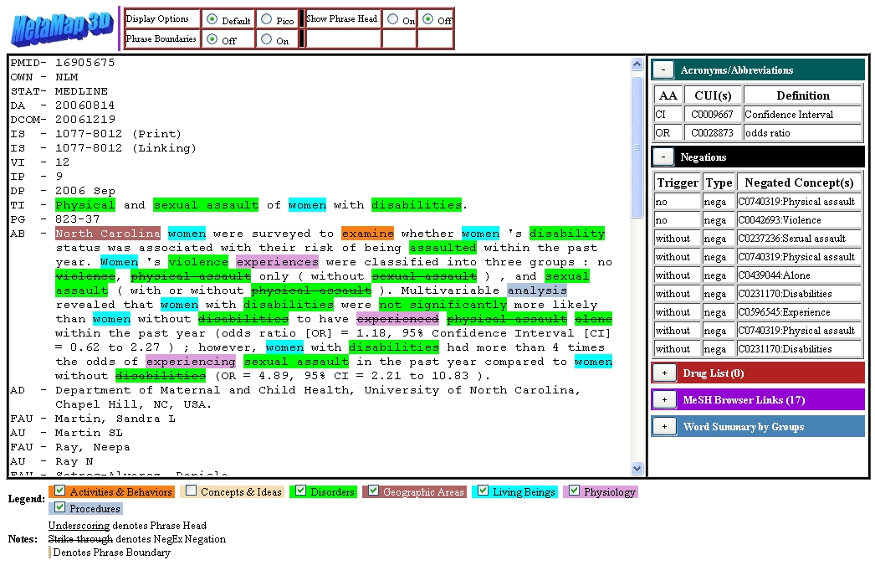

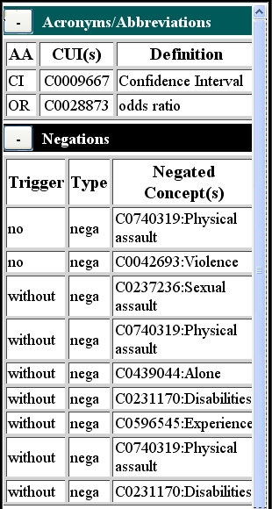
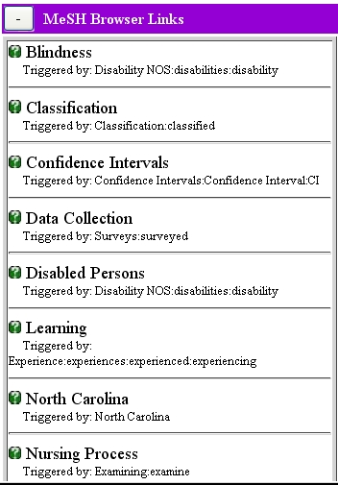
Output Formats: MetaMap 3D

Slide 47
Tutorial Outline
Background: why concept identification? (Lan)
Introduction to MetaMap (Lan)
The MetaMap algorithm (Lan)
Input/output formats (François, Jim)
MetaMap options in depth (Lan)
MetaMap processing modes (Lan)
Usage warnings (Lan)
Access methods (Jim)
Research projects using MetaMap (Jim, Dina)
Future directions (Lan)

Slide 48
MetaMap Options
Word Sense Disambiguation (WSD, -y)
  Based on Susanne Humphrey’s Journal Descriptor Indexing (Humphrey et al., 1998, 2006)
  Provides modest improvement in results
Negation (--negex)
  Important for clinical text
  Based on Wendy Chapman’s NegEx algorithm (Chapman et al., 2001)
Behavior options
Output/Display options

Slide 49
WSD Examples (1/4)
“Fifteen (6.4%) of 234 colds treated with placebo…”
  Cold (cold temperature) [npop]
  Cold (Common Cold) [dsyn]
  Cold (Cold Sensation) [phsf]

Slide 50
WSD Examples (2/4)
“… the drugs were compared in two four-point, double-blind bioassays.”
  double (Diplopia) [dsyn] vs. Double (Duplicate) [ftcn]
  Blind (Blind Vision) [dsyn] vs. BLIND (Blinded) [resa] vs. Blind (Visually Impaired Persons) [podg]
  Bioassays (Biological Assay) [lbpr]

Slide 51
WSD Examples (3/4)
“More neuroactive substances were prescribed for patients with superior mentation and minimal physical disability; the difference between low and high groups was 1.7 (mentation) and 2.8 (physical status).”
  High (Euphoric mood) [menp] vs. High [qlco]
  Groups [inpr]
WRONG

Slide 52
WSD Examples (4/4)
“The authors conclude that these cases of progressive hepatic disease with histologic changes simulating those found in livers of alcoholic patients offer evidence that heavy alcohol consumption may affect the liver in an indirect fashion.”
  Liver (Entire liver) [bpoc] vs. Liver [bpoc]
  vs. LIVER (Liver Extract) [orch,phsu]
WRONG

Slide 53
Negation Example
“There is no focal infiltrate or pleural effusion.”
--negex output (in addition to normal output):
NEGATIONS:
Negation Type: nega
Negation Trigger: no
Negation PosInfo: 9/2
Negated Concept: C0332448:Infiltrate
Concept PosInfo: 18/10
Negation Type: nega
Negation Trigger: no
Negation PosInfo: 9/2
Negated Concept: C2073625:pleural effusion, C0032227:Pleural Effusion
Concept PosInfo: 32/16

Slide 54
Behavior Options (1/4)
Data model options
-A --strict_model (the default; focused on concepts likely to be found in text)
-C --relaxed_model (includes most Metathesaurus content)
Major options highlighted earlier
-y --word_sense_disambiguation
--negex
Other major options
-Q --quick_composite_phrases (experimental, for well-behaved larger phrases: pain on the left side of the chest)
-i --ignore_word_order

Slide 55
Example: Default (with word order)
Phrase: “Jurkat T cells”
Meta Candidates (8):
913 Jurkat Cells [Cell]
901 T-Cells (T-Lymphocyte) [Cell]
827 Cells [Cell]
793 Cell (Entire cell) [Cell]
793 Cell (Cell Device Component) [Medical Device]
793 Cell (Cell (compartment)) [Spatial Concept]
743 Cellular [Functional Concept]
721 Cellularity [Qualitative Concept]
Meta Mapping (913):
913 Jurkat Cells [Cell]

Slide 56
Example: Ignore Word Order (-i)
Phrase: “Jurkat T cells”
Meta Candidates (8):
882 T-Cells (T-Lymphocyte) [Cell]
858 Jurkat Cells [Cell]
790 Cells [Cell]
756 Cell (Entire cell) [Cell]
756 Cell (Cell Device Component) [Medical Device]
756 Cell (Cell (compartment)) [Spatial Concept]
706 Cellular [Functional Concept]
684 Cellularity [Qualitative Concept]
Meta Mapping (882):
882 T-Cells (T-Lymphocyte) [Cell]

Slide 57
Behavior Options (2/4)
Browse mode options (example below)
-z --term_processing
-o --allow_overmatches
-g --allow_concept_gaps
-m --hide_mappings
Inference mode options (example below)
-Y --prefer_multiple_concepts
With --term_processing,
“cancer of the lung” →
‘Cancer of the Lung’ (‘Malignant neoplasm of lung’)
instead of two phrases →
‘Cancer’ (…) and ‘Lung’ (…)
With --allow_overmatches, “medicine” →
‘Alternative Medicine’, ‘Medical Records’, …
With ––allow_concept_gaps, “mouse protein” →
‘Ly6d protein, mouse’ among over 8,000 results

Slide 58
Behavior Options (3/4)
Parsing/lexical options (not often used)
-t --no_tagging
-d --no_derivational_variants
-D --all_derivational_variants
-a --all_acros_abbrs
-u --unique_acros_abbrs_only
List truncation options (reduces tenuous matches and saves processing time)
-r --threshold <integer>

Slide 59
Behavior Options (4/4)
Source/ST limitation options
-R --restrict_to_sources <list>
-e --exclude_sources <list>
-J --restrict_to_sts <list>
-k --exclude_sts <list>

Slide 60
Output/Display Options (1/2)
Human-readable output/display options
-p --hide_plain_syntax
-x --syntax
-T --tagger_output
-v --variants
-c --hide_candidates
-m --hide_mappings
-I --show_cuis
-s --hide_semantic_types
-G --sources
Useful for explaining MetaMap’s behavior

Slide 61
Output/Display Options (2/2)
Other output/display options (override human-readable options)
-q --machine_output
-N --fielded_mmi_output (mmi = MetaMap Indexing)
-% --XML <none> (format or noformat)

Slide 62
Tutorial Outline
Background: why concept identification? (Lan)
Introduction to MetaMap (Lan)
The MetaMap algorithm (Lan)
Input/output formats (François, Jim)
MetaMap options in depth (Lan)
MetaMap processing modes (Lan)
Usage warnings (Lan)
Access methods (Jim)
Research projects using MetaMap (Jim, Dina)
Future directions (Lan)

Slide 63
MetaMap Processing Modes
Semantic mode (the normal, default mode)
  Seeks correct, or best, answer
  Uses MetaMap’s strict data model
Inference mode (-Y, --prefer_multiple_concepts)
  Similar to semantic mode except
  Prefers multiple concepts to facilitate inferencing
Browse mode (-zogm, --term_processing
--allow_overmatches --allow_concept_gaps
--hide_mappings)
  Seeks all answers, even tenuous ones
  Often uses MetaMap’s relaxed data model (-C)
  Often includes –i, --ignore_word_order

Slide 64
Example: Semantic Mode (with WSD)
-y, --word_sense_disambiguation
> metamap –y
…
Phrase: "bladder cancer"
Meta Candidates (10):
1000 bladder cancer (Malignant neoplasm of urinary bladder) [Neoplastic Process]
1000 Bladder Cancer (Carcinoma of bladder) [Neoplastic Process]
861 Bladder (Urinary Bladder) [Body Part, Organ, or Organ Component]
861 Cancer (Malignant Neoplasms) [Neoplastic Process]
861 Cancer (Neoplasm) [Neoplastic Process]
861 Cancer (Cancer Genus) [Eukaryote]
861 Bladder (Entire bladder) [Body Part, Organ, or Organ Component]
861 Cancer (Primary malignant neoplasm) [Neoplastic Process]
861 Cancer (Cancer:-:Point in time:^Patient:-) [Clinical Attribute]
805 Vesical (Vesico-) [Spatial Concept]
Meta Mapping (1000):
1000 Bladder Cancer (Carcinoma of bladder) [Neoplastic Process]

Slide 65
Example: Inference Mode (with WSD)
metamap –yY
…
Phrase: "bladder cancer"
Meta Candidates (10):
694 Bladder (Urinary Bladder) [Body Part, Organ, or Organ Component]
694 Cancer (Malignant Neoplasms) [Neoplastic Process]
694 Cancer (Neoplasm) [Neoplastic Process]
694 Cancer (Cancer Genus) [Eukaryote]
694 Bladder (Entire bladder) [Body Part, Organ, or Organ Component]
694 Cancer (Primary malignant neoplasm) [Neoplastic Process]
694 Cancer (Cancer:-:Point in time:^Patient:-) [Clinical Attribute]
666 bladder cancer (Malignant neoplasm of urinary bladder) [Neoplastic Process]
666 Bladder Cancer (Carcinoma of bladder) [Neoplastic Process]
638 Vesical (Vesico-) [Spatial Concept]
Meta Mapping (777):
694 Bladder (Entire bladder) [Body Part, Organ, or Organ Component]
694 Cancer (Malignant Neoplasms) [Neoplastic Process]
-y, --word_sense_disambiguation
-Y, --prefer_multiple_concepts

Slide 66
Example 1/2: Browse Mode
-z, --term_processing
-o, allow_overmatches
-g, allow_concept_gaps
-m, --hide_mappings
> metamap –zogm
…
Phrase: "bladder cancer"
Meta Candidates (5597):
1000 bladder cancer (Malignant neoplasm of urinary bladder) [Neoplastic Process]
Cancer of Bladder
Malignant Bladder Neoplasm
1000 Bladder Cancer (Carcinoma of bladder) [Neoplastic Process]
BLADDER CARCINOMA
Cancer of Bladder
861 Bladder (Urinary Bladder) [Body Part, Organ, or Organ Component]
861 Cancer (Malignant Neoplasms) [Neoplastic Process]
…
583 gall bladder (Gallbladder) [Body Part, Organ, or Organ Component]
583 Cancer Hospital (Hospitals, Cancer) [Health Care Related Organization,Manufactured Object]
…

Slide 67
Example 2/2: Browse Mode
-z, --term_processing
-o, allow_overmatches
-g, allow_concept_gaps
-m, --hide_mappings
> metamap –zogm
…
Phrase: “achilles reflex"
Meta Candidates (815):
861 Achilles (Structure of achilles tendon) [Body Part, Organ, or Organ Component]
861 Reflex (Reflex action) [Organ or Tissue Function]
861 reflex (Reflex motion descriptor) [Organ or Tissue Function]
861 Reflex (Observation of reflex) [Finding]
827 Achilles tendon reflex (Ankle reflex) [Clinical Attribute]
Ankle reflex
827 reflexes (Examination of reflexes) [Diagnostic Procedure]
722 examination of Achilles reflex [Diagnostic Procedure]
ankle reflex exam
679 intensity of left Achilles tendon reflex [Finding]
left ankle jerk reflex
679 intensity of right Achilles tendon reflex [Finding]
right ankle jerk reflex
583 Gag reflex (Gagging) [Finding]
…

Slide 68
Tutorial Outline
Background: why concept identification? (Lan)
Introduction to MetaMap (Lan)
The MetaMap algorithm (Lan)
Input/output formats (François, Jim)
MetaMap options in depth (Lan)
MetaMap processing modes (Lan)
Usage warnings (Lan)
Access methods (Jim)
Research projects using MetaMap (Jim, Dina)
Future directions (Lan)

Slide 69
Candidates vs. Mappings
The mappings are MetaMap’s final answer to text input
The candidate list is an intermediate result
  Often contains many bad matches among the good ones (similar to Browse mode results vs. Semantic mode results)
  Should be used judiciously/selectively and only when mappings are found to be inadequate

Slide 70
Candidates vs. Mappings Example
Phrase: "heart attack"
Meta Candidates (8):
1000 Heart attack (Myocardial Infarction) [Disease or Syndrome]
861 Heart [Body Part, Organ, or Organ Component]
861 Attack, NOS (Onset of illness) [Finding]
861 Attack (Attack device) [Medical Device]
861 attack (Attack behavior) [Social Behavior]
861 Heart (Entire heart) [Body Part, Organ, or Organ Component]
861 Attack (Observation of attack) [Finding]
827 Attacked (Assault) [Injury or Poisoning]
Meta Mapping (1000):
1000 Heart attack (Myocardial Infarction) [Disease or Syndrome]

Slide 71
Tutorial Outline
Background: why concept identification? (Lan)
Introduction to MetaMap (Lan)
The MetaMap algorithm (Lan)
Input/output formats (François, Jim)
MetaMap options in depth (Lan)
MetaMap processing modes (Lan)
Usage warnings (Lan)
Access methods (Jim)
Research projects using MetaMap (Jim, Dina)
Future directions (Lan)

Slide 72
MetaMap Availability
Web access (start here)
  Interactive and batch (file) processing via Scheduler
  http://skr.nlm.nih.gov/
MMTx (MetaMap Transfer) (becoming obsolete)
  Java-based implementation of MetaMap
  http://mmtx.nlm.nih.gov/
  MetaMap vs. MMTx
MetaMap itself
  Initial release (for Linux): September, 2008
  http://metamap.nlm.nih.gov/
All usage requires UMLS license agreement

Slide 73
MetaMap APIs
Java MetaMap API
  http://metamap.nlm.nih.gov/#MetaMapJavaApi
Java API to SKR Scheduler
  http://skr.nlm.nih.gov/SKR_API
MetaMap UIMA Annotator
  http://metamap.nlm.nih.gov/#MetaMapUIMA

Slide 74
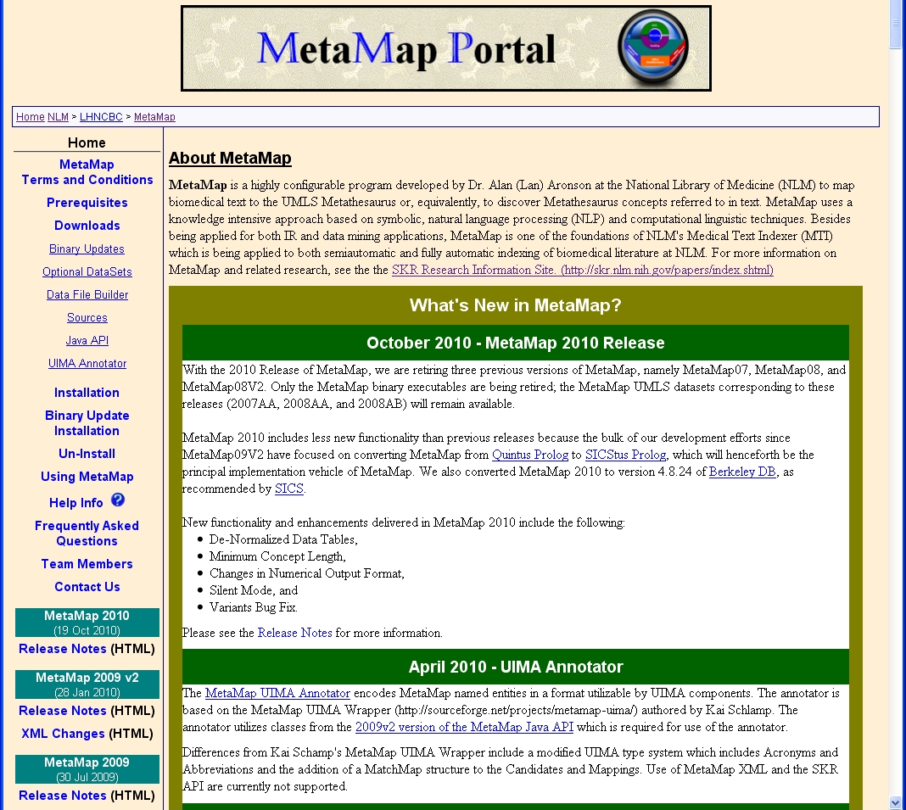
MetaMap/MMTx Distribution Modes
http://metamap.nlm.nih.gov

Slide 75
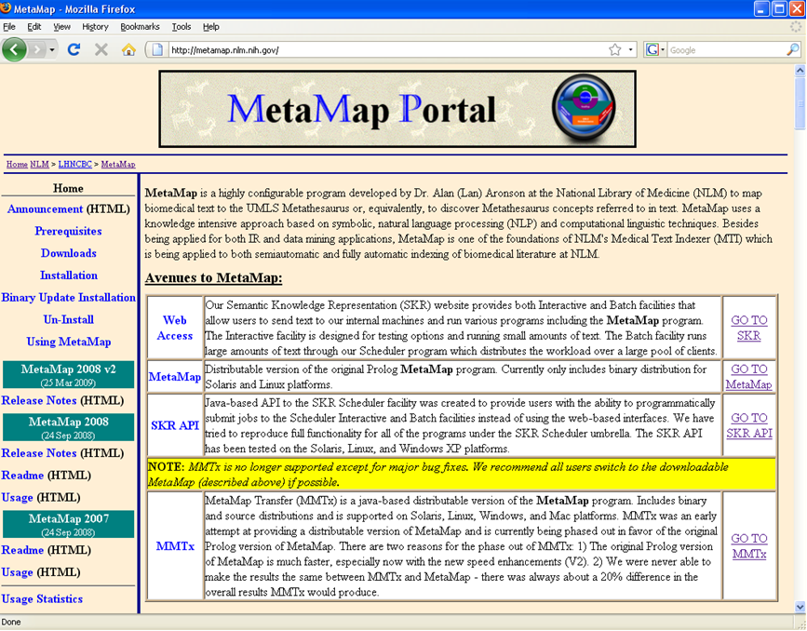
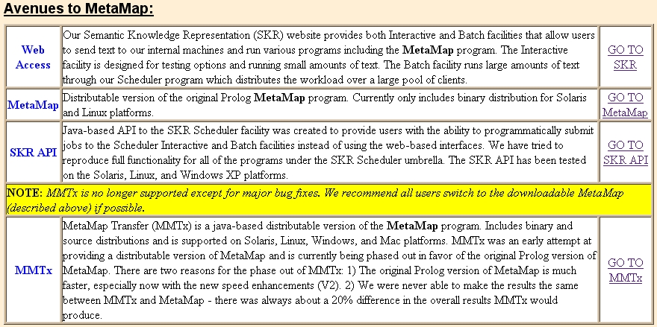
MetaMap/MMTx Distribution Modes
http://metamap.nlm.nih.gov

Slide 76
Tutorial Outline
Background: why concept identification? (Lan)
Introduction to MetaMap (Lan)
The MetaMap algorithm (Lan)
Input/output formats (François, Jim)
MetaMap options in depth (Lan)
MetaMap processing modes (Lan)
Usage warnings (Lan)
Access methods (Jim)
Research projects using MetaMap (Jim, Dina)
Future directions (Lan)

Slide 77
NLM Applications using MetaMap: MTI
(Medical Text Indexer)
Black
Box
Black
Box
Black
Box
Product of Indexing Initiative
Assists NLM Indexers
Production since mid-2000
Uses article Title and Abstract
Semi-Automatic MeSH Indexing Recommendations
Automatic Keyword Indexing
Notes:
General overview of what MTI is and how it is currently being used
-- For Cataloging and HMD we use Title and a combination of the 520 Summary
field and any Library of Congress Subject Headings to make up an “Abstract”
like structure.
-- We have done some full text studies and came up with only slightly better
results than using just the Title and Abstract.

Slide 78
MTI Uses
Assisted indexing of MEDLINE/PubMed articles (DCMS)
  Citations processed nightly
Assisted indexing of Cataloging (TSD) and History of Medicine Division (HMD) records
  Production mid-2007
  Easy modification to MTI to accommodate differences
  Tightly integrated into their workflow
Automatic indexing of NLM Gateway meeting abstracts
Notes:
General overview of what MTI is and how it is currently being used
-- For Cataloging and HMD we use Title and a combination of the 520 Summary
field and any Library of Congress Subject Headings to make up an “Abstract”
like structure.
-- We have done some full text studies and came up with only slightly better
results than using just the Title and Abstract.

Slide 79

How MTI Uses MetaMap
Dominate input pathway (weighted 7 – 2 over PRC)
Calls MetaMap twice
Pass I – cast a wide net to identify as many UMLS concepts as possible, while balancing time constraints
  metamap –iDN
  Ignore Word Order (-i)
  All Derivational Variants (-D)
  Fielded MMI Output (-N)

Slide 80
How MTI Uses MetaMap (contd.)
Pass II – more focused review for actual MeSH Headings in the text, reinforces Pass I items
  metamap –dN –R ‘MSH’
  No Derivational Variants (-d)
  Fielded MMI Output (-N)
  Restrict to Sources (-R) restricted to MeSH

Slide 81
MetaMap Fielded MMI Output (-N)
17285228|MM|430.78|Homocystine|C0019879|[aapp,bacs]|["Homocystine"-ab-3-"Homocysteine","Homocystine"-ab-2-"homocysteine","Homocystine"-ab-1-"Homocysteine","Homocystine"-ti-1-"homocysteine"]|TI;AB|406:12|227:12|74:12|35:12
17285228 (PMID)
MM (Path Name)
430.78 (Score)
Homocystine (UMLS Concept Found Preferred Name)
C0019879 (UMLS Concept Unique Identifier)
[aapp,bacs] (List of Semantic Type(s))
["Homocystine"-ab-3-"Homocysteine","Homocystine"-ab-2-"homocysteine","Homocystine"-ab-1-"Homocysteine","Homocystine"-ti-1-"homocysteine"] (List of Entry Term Quartets)
TI;AB (Location(s), boost scores for TI)
406:12|227:12|74:12|35:12 (List of Positional Information Groups [start:length])
Entry Term Quartet
"Homocystine"-ab-2-"homocysteine"
"Homocystine" – UMLS Concept Preferred Name
ab – Found in Abstract
2 – Found in section’s second utterance
"homocysteine" – Actual text used for mapping

Slide 82
Filtering Using Entry Term Information
Homocystine vs Homocysteine
0000000|MM|424.55|Homocystine|C0019879|[aapp,bacs]
|["Homocystine"-ti-1-"Homocystine"]|TI|20:11
0000000|MM|424.55|homocysteine|C0019878|[aapp,bacs]
|["homocysteine"-ti-1-"Homocystine"]|TI|20:11
Borne → Bear
0000000|MM|734.96|Ursidae Family|C0004897|[mamm]
|["Bear"-ti-1-"borne"]|TI|32:5
0000000|MM|112.74|Bearing Device Component|C1704689|[medd]
|["Bearing"-ti-1-"borne"]|TI|32:5
0000000|MM|112.74|Caliber|C1301886|[qnco]
|["Bore"-ti-1-"borne"]|TI|32:5

Slide 83
Example
Text: preventing hemorrhage pre-operatively
No Derivational Variants (-d)
  812 HAEMORRHAGE NOS (Hemorrhage) [Finding]
Needs both
to find
  All Derivational Variants + Ignore Word Order (-iD)
  783 Operative haemorrhage (Blood Loss, Surgical) [Pathologic Function]
Examples from metamap10 with 2010AA UMLS

Slide 84
Ambiguity Example
Text: respirable particulate matter
No Derivational Variants (-d)
  Nothing for “respirable”
Only needs
-D to find
  All Derivational Variants + Ignore Word Order (-iD)
  523 respiration (Cell Respiration) [Cell Function]
  523 Respirator (Mechanical Ventilator) [Medical Device]
  523 Respiration [Physiologic Function]
  523 respirator (Treatment with respirator) [Therapeutic or Preventive Procedure]
  523 respiration (respiratory gaseous exchange in organisms) [Biologic Function]
Examples from metamap10 with 2010AA UMLS

Slide 85




NLM Applications using MetaMap: RIDeM (Repository for Informed Decision Making)
Summarization
  Meta-analysis, Reviews
  Drugs (indications, interactions, etc.)
Clinical question answering (CQA 1.0)
RIDeM
GUI API
Information for patients
Linking evidence to patient records (InfoBot)
Image retrieval (iMEDLINE)
Annotation of Interactive Publications
Clinical research (HDiscovery)
Translational research: linking of basic research to clinical information

Slide 86



Example data flow: InfoBot
Local modules
automatically extract
selected patient data
1
3
2
5
transmit to InfoBot
Local modules
automatically display
requested data
4
format and send requested data

Slide 87
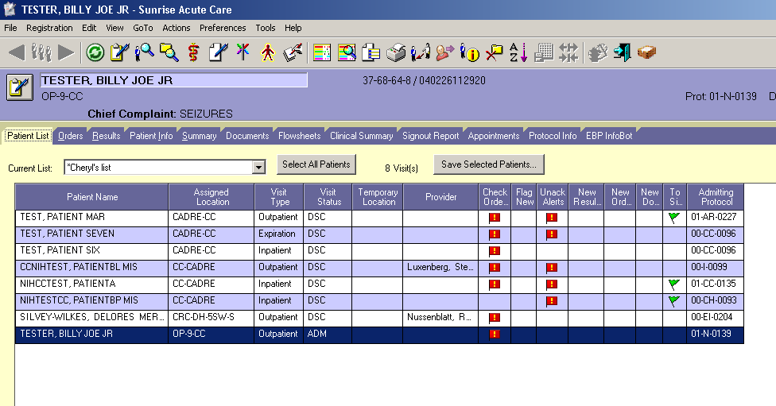
CRIS: the EHR Sunrise Clinical Manager at the NIH Clinical Center. Patient list is displayed on login. Tabs provide access to clinical tasks.

Slide 88
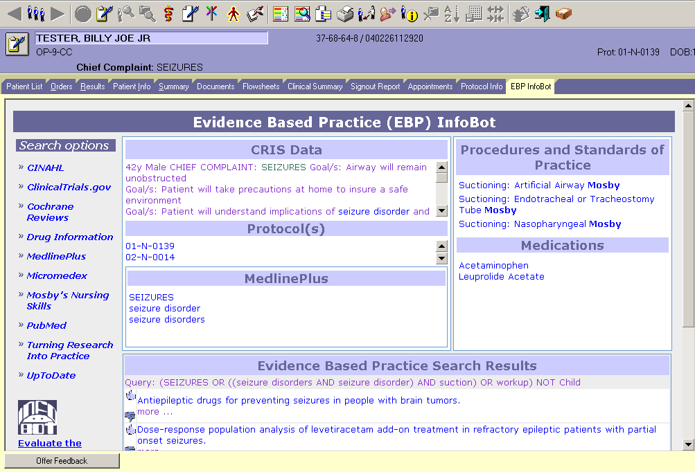
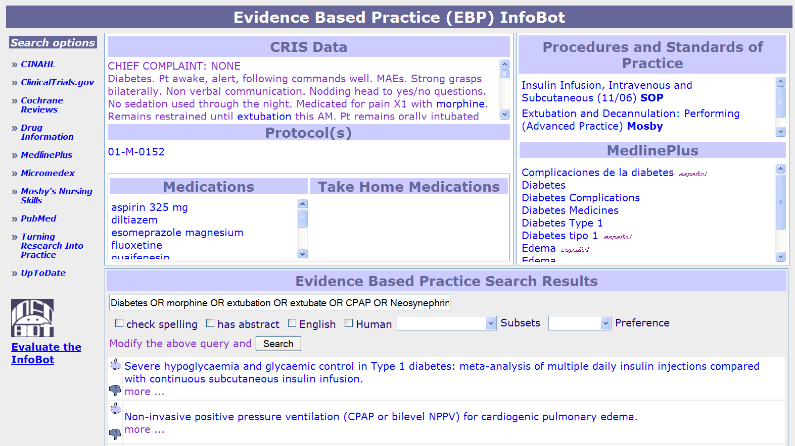
Evidence Based Practice tab in CRIS
Notes:
88

Slide 89
Text types processed for RIDeM
 | Format | Encoding | Length | idiosyncrasies
MEDLINE abstracts | XML | UTF-8 | ~300 words | structured /not , well-formed
Clinical questions | unknown | unknown | ~10 | Structured /not
Clinical notes | “ASCII art” | unknown | 20--600 | ungrammatical
Case descriptions | unknown | unknown | ~700 | well-formed/not
Full-text journal articles Interactive Publications | HTML, PDF, XML… | UTF-8 | ~3,000 | structured/not, well-formed
DailyMed drug package inserts | XML+SPL | UTF-8 | ~800 | structured, well-formed

Slide 90
Text pre-processing
Required (batch file submission and API)
  ASCII encoding
  Size under 2,000 - 3,000 characters
  Format (MEDLINE, free text, single line, etc.)
Sensible
  Isolate sections/passages for entity extraction
    Indication section of a drug label, image description in the article
  Remove mark-up tags
  Expand colloquial abbreviations
    In the NIH CC notes MAN=Multiple Endocrine Neoplasia
Optional
  Split HTML lists into items
  Use a third party parser to extract phrases

Slide 91
MetaMap settings
Access mode
  Batch file submission
    DailyMed package inserts processing
    Full-text processing for image text indexing
  API
    Note and question processing (back-off to local table look-up)
Options
  Default for experiments
  Subset semantic types to disorders, interventions, anatomy
Output format
  Machine (trade-off between ease of processing and volume)

Slide 92
MetaMap output processing
Extract into RIDeM concept container:
  Lexical match
  Concept unique identifier
  Concept preferred name
  Semantic types list
  Negation status
  Phrase type
  POS list
  First character offset
  Length

Slide 93
Target entity extraction: InfoBot clinical notes
UMLS-based recognition of the elements of a well-formed clinical question (Patient/Problem-Intervention)
Example text
  1st Research Participation Problem: Hodgkin's Disease; Lymphoma, Post MRD HSCT;
  Goal/s: Pt will verbalize understanding of role in research participation/protocol and about the disease process.
  Planned Interventions: Obtain/Monitor Labs per protocol. Review results of tests such as CT scan/PET/DEXA scans. Have LIP or MD discuss protocol with pt and keep patient up-to-date on progress. Pt to keep appointments with follow-up clinics and tests. Provide pt with reference materials, internet access, information about medications and education materials. Pt to follow plan of care by LIP and ask questions to address concerns.
Allogeneic Hematopoietic Stem Cell Transplantation
HLA-matched related donor
Dual Energy
X-ray Absorptiometry
Licensed independent practitioner

Slide 94
Default MetaMap output analysis
  1st Research Participation Problem: Hodgkin's Disease; Lymphoma, Post MRD HSCT;
  Goal/s: Pt will verbalize understanding of role in research participation/protocol and about the disease process.
  Planned Interventions: Obtain/Monitor Labs per protocol. Review results of tests such as CT scan/PET/DEXA scans. Have LIP or MD discuss protocol with pt and keep patient up-to-date on progress. Pt to keep appointments with follow-up clinics and tests. Provide pt with reference materials, internet access, information about medications and education materials. Pt to follow plan of care by LIP and ask questions to address concerns.
  correct sense; correct sense, but high level; wrong sense (FP and FN); ignored

Slide 95
Entity extraction
Discard lexical matches under four characters (unless MetaMap identified an author-defined abbreviation – scientific publications, or the abbreviation is on the clinical institution local list)
Mark high-level terms (using a local look-up list)
Discard stop-words (using a local look-up list)
Apply document-specific extraction methods
  MEDLINE abstracts – position in the document, frequency, co-occurrence, classifiers

Slide 96
Entity extraction: Case description
72 yo male admitted from Location Hosp s-p seizure activity. Pt has pmh of hodgkins dx, s-p chemo, and HTN. Pt had gone to hospital on Date for confusion and unsteady gait, head CT was negative and pt sent home on ASA. Returned on Date with focal seizure and then grand mal and was admitted to Location Hospital ICU. Started on Ativan gtt. MRI done showing diffuse lesions consistent with encephalitis. Head CT with ? of embolic stroke. Pt continued with seizures and transferred to Location for further workup.
correct
nothing extracted
wrong
?
Problem
Population
Intervention
?
?
?
93% 0% 7%
97% 0% 3%
84% 0% 16%

Slide 97
Entity extraction: MEDLINE abstracts
Allogeneic hematopoietic stem-cell transplantation in patients with hematologic malignancies after dose-escalated treosulfan/fludarabine conditioning.
PURPOSE: Treosulfan was introduced recently as a conditioning agent for allogeneic blood stem-cell transplantation. The favorable nonhematologic toxicity profile at 3 x 10 g/m(2) was the basis for dose escalation in this prospective, multicenter trial.
PATIENTS AND METHODS: Fifty-six patients with various hematologic malignancies who were not eligible for standard conditioning were treated with one of three doses: 10 g/m(2), 12 g/m(2), or 14 g/m(2) of intravenous treosulfan, which was administered on days -6 to -4 combined with fludarabine 30 mg/m(2) on days -6 to -2. Patients in complete remission (CR; 42%) or non-CR (58%) received grafts from matched related (47%) or matched unrelated (51%) donors; one patient had a mismatched related donor (2%).
RESULTS: No engraftment failure occurred. Overall, extramedullary toxicity and the nonrelapse mortality rate at 2 years (20%) were low and did not increase with dose. Cumulative incidence of relapse/progression reached 31%. The overall survival and progression-free survival rates were 64% and 49%, respectively, in the total study population. An inverse dose dependency of relapse incidence was indicated in the subgroup receiving transplantations from matched related donors (P = .0568).
CONCLUSION: Treosulfan-based conditioning was feasible at all three doses. The 3 x 14 g/m(2) dose was selected for additional studies, because it combines desired characteristics of low toxicity and a low relapse rate.
correct
nothing extracted
wrong
?
Problem
Population
Intervention
Outcome
?
?
?
?
90% 5% 5%
80% 13% 7%
80% 0% 20%
95% 0% 5%

Slide 98
MetaMap UMLS clinical content views
  Experiments
    2008 Extract PICO frames from MEDLINE abstracts
    2009 Extract PICO elements from clinical notes
Data
    2008 LNCV document collection
    2009 LNCV clinical text collection
Conclusions
  Different tasks need different MetaMap views
    Filters
    Semantic type subsets

Slide 99
Tutorial Outline
Background: why concept identification? (Lan)
Introduction to MetaMap (Lan)
The MetaMap algorithm (Lan)
Input/output formats (François, Jim)
MetaMap options in depth (Lan)
MetaMap processing modes (Lan)
Usage warnings (Lan)
Access methods (Jim)
Research projects using MetaMap (Jim, Dina)
Future directions (Lan)

Slide 100
Ongoing MetaMap Development (1/2)
Technical algorithm enhancements resulting in at least 3x speedup in MetaMap execution
  MetaMap is now up to 10 times faster than MMTx
Environment development
  Migration from Sun/Solaris to Linux environment
  Update to current Berkeley DB to coordinate with migration from Quintus to SICStus Prolog
  Release of MetaMap for OS X and soon for Windows
MetaMap 3D (colorized MetaMap output)
Detection of user-defined acronyms

Slide 101
Ongoing MetaMap Development (2/2)
  Higher-order tokenization
    Detection of author-defined acronyms/abbreviations
    To be augmented with recognition of chemical names, bibliographic references, numeric quantities, etc.
  Negation detection (--negex)
  Word sense disambiguation (WSD, -y)
    Currently based on Journal Descriptor Indexing (JDI)
    To be augmented and combined with other, Machine Learning approaches (Antonio Jimeno-Yepes)

Slide 102
Future MetaMap Development (1/2)
Release MetaMap for Windows
Further develop API services
Enhance MetaMap’s accuracy with additional WSD algorithms
Augment tokenization with recognition of chemical names, bibliographic references, numeric quantities, etc.
Complete composite phrase processing (e.g., pain on the left side of the chest)

Slide 103
Future MetaMap Development (2/2)
Enhance of processing short words, including acronyms/abbreviations
Handle space/hyphen/null alternation (e.g., breast feed/breast-feed/breastfeed)
Tune MetaMap’s evaluation metric to improve accuracy
Technical enhancements in graceful back-off for long phrases
Incorporate user-suggested improvements

Slide 104
Web Pointers*
2010 AMIA MetaMap Tutorial (T29: UMLS Concept Identification using the MetaMap System) slides available at: http://skr.nlm.nih.gov/papers/
Semantic Knowledge Representation Project: http://skr.nlm.nih.gov/ (interactive/batch MetaMap, MTI, SemRep, …)
MetaMap Portal: http://metamap.nlm.nih.gov/ (downloadable binary version of Prolog/C implementation, API, …)
NLM Indexing Initiative: http://ii.nlm.nih.gov/ (general II or MTI information)
* All MetaMap access requires a UMLS license: http://www.nlm.nih.gov/research/umls/license.html
Start here

Slide 105
Tutorial Faculty Pointers
Alan (Lan) R. Aronson: alan@nlm.nih.gov
Dina Demner-Fushman: ddemner@mail.nih.gov
François-Michel Lang: flang@mail.nih.gov
James G. Mork: mork@nlm.nih.gov

Slide 106
Comments or Questions?

