Slide 1
Using MetaMap: A Tutorial
BioNLP Workshop June 27, 2014 4:00pm – 5:30pm
Alan R. Aronson
François-Michel Lang James G. Mork

Slide 2
Disclaimer
The views and opinions expressed do not necessarily state or reflect those of the U.S. Government, and they may not be used for advertising or product endorsement purposes.

Slide 3
Tutorial Outline
Purpose and foundations of MetaMap (Lan)
The MetaMap algorithm (Lan)
Input/output formats (François)
Scenarios (François)
Access methods (Jim)
Case Studies (Jim, Lan)
Future directions (Lan)

Slide 4
MetaMap’s Purpose: Concept Identification
AKA Named-entity recognition
Identify UMLS Metathesaurus concepts in text
Important and difficult problem
MetaMap’s dual role:
Local: Critical component of NLM’s Medical Text Indexer (MTI)
Global: Prominent biomedical concept-identification application
Notes:
… Concept identification is an important and difficult problem,
in fact, one that is likely to remain an active research area for the foreseeable future.
But it’s a problem that MetaMap has done a pretty good job at.
As a measure of our success, we can point to MetaMap’s dual role
inside and outside the Library.
Locally, MetaMap *IS* a critical component of the library’s Medical Text Indexer MTI, which Jim has presented to this audience,
and
Globally, MetaMap has a very active life of its own as a standalone application,
and has established itself as A pre-eminent tool for biomedical concept identification.
We can gauge MetaMap’s increasing popularity
by tracking references to MetaMap in the biomedical literature.

Slide 5
MetaMap - Foundations
Knowledge-intensive approach
NLP and linguistics methods
Emphasize thoroughness over efficiency
However…efficiency is still important!
Notes:
Very briefly, some of MetaMap’s foundations are
* a knowledge-intensive approach to processing text, and
* use of Natural Language Processing
It’s certainly possible to do a quick-n-dirty job of concept identification
simply by brute-force keyword searching and the like,
but our processing is considerably more complex.
…
As the Metathesaurus has grown, MetaMap’s efficiency has decreased,
and I’ll be talking about how we’ve handled that growth later in the presentation.
Let’s take a look now at some of the complexity we encounter.

Slide 6
Concept Identification: Example 1
sister-chromatid exchange genotoxicity assays
C1519335:Sister Chromatid Exchange Assay
Text gap, lexical variation: assay/assays

Slide 7
Concept Identification: Example 2
medial branches of the posterior medial rami of the spinal nerves
C2327452:Medial branch of
posterior ramus of spinal nerve
Term processing, text gaps, lexical variation: branch/branches, ramus/rami, nerve/nerves

Slide 8
Concept Identification: Example 3
pain on the left side of the chest
C0541828:chest pain left side
(Left sided chest pain)
Composite phrases, word order, text gaps

Slide 9
Concept Identification: Example 4
fixed-dose combination treatment groups
Extreme ambiguity leads to 756 results (final mappings)
WSD reduces 756 mappings to just one:
Meta Mapping (822):
637 C0443218:Fixed (Fixed behavior) [qlco]
637 C0178602:Dose (Dosage) [qnco]
637 C1947911:Combination (combination of objects)
[phob]
804 C0087111:Treatment (Therapeutic procedure) [topp]
804 C1705429:Group (User Group) [popg]

Slide 10
Tutorial Outline
Purpose and foundations of MetaMap (Lan)
The MetaMap algorithm (Lan)
Input/output formats (François)
Scenarios (François)
Access methods (Jim)
Case Studies (Jim, Lan)
Future directions (Lan)

Slide 11
The Algorithm
Parsing
SPECIALIST minimal-commitment parser
SPECIALIST lexicon
MedPost part-of-speech tagger
Variant generation
SPECIALIST lexicon
Lexical Variant Generation (LVG)
Candidate retrieval from the Metathesaurus
Candidate evaluation
Mapping construction

Slide 12
Tutorial Outline
Purpose and foundations of MetaMap (Lan)
The MetaMap algorithm (Lan)
Input/output formats (François)
Scenarios (François)
Access methods (Jim)
Case Studies (Jim, Lan)
Future directions (Lan)

Slide 13
Input Formats
PMID- 5768363
OWN - NLM
STAT- MEDLINE
DA - 19690626
DCOM- 19690626
LR - 20131121
PUBM- Print
IS - 0036-8075
VI - 164
IP - 3882
DP - 1969 May 23
TI - Cell population kinetics: a modified interpretation of the graph of labeled
mitoses.
PG - 952-4
AB - Graphs of labeled mitoses, derived from autoradiographs of cell populations with
(3)H-thymidine, show depressions in the curves at their midpoints. These
depressions reflect interruption of DNA synthesis midway through S phase. Such
interruptions revealed by the method of labeled mitoses should be considered
when determining cell-cycle times.
FAU - Hamilton, A I
AU - Hamilton AI
LA - eng
PT - Journal Article
PL - UNITED STATES
TA - Science
JT - Science (New York, N.Y.)
JID - 0404511
Unformatted ASCII English free text (input records by default delimited by blank line), or…
MEDLINE Citations
Single-line delimited input (--sldi: term processing)
Single-line delimited input with ID input (--sldiID)
Written informed consent.
Age 18 years or older.
informed consent.
Male or female.
At least 18 years of age.
Able to give informed consent.
Signed informed consent.
Healthy.
Male.
Negative pregnancy test.
Signed written informed consent.
Ability to understand document.
Measurable disease.
ECOG performance status 0-2.
Signed informed consent.
Adult patients, >/= 18 years of age.
Type 2 diabetes.
Other protocol-defined criteria.
Txt001|Written informed consent.
Txt002|Age 18 years or older.
Txt003|informed consent.
Txt004|Male or female.
Txt005|At least 18 years of age.
Txt006|Able to give informed consent.
Txt007|Signed informed consent.
Txt008|Healthy.
Txt009|Male.
Txt010|Negative pregnancy test.
Txt011|Signed written informed consent.
Txt012|Ability to understand document.
Txt013|Measurable disease.
Txt014|ECOG performance status 0-2.
Txt015|signed informed consent.
Txt016|Adult patients, >/= 18 years of age.
Txt017|Type 2 diabetes.
Txt018|Other protocol-defined criteria.
Notes:
We also handle several other formats
--sldi for Term Processing
Now, present a few caveats – some cases to be careful about.
Next: Syntactic Structure, Bulleted Lists

Slide 14
Input Should Have Syntactic Structure
Lack of syntactic structure → long phrases → combinatorial explosion in mappings
protein-4 FN3 fibronectin type III domain GSH lutathione GST glutathione S-transferase hIL-6 human interleukin-6 HSA human serum albumin IC(50) half-maximal inhibitory concentration Ig immunoglobulin IMAC immobilized metal affinity chromatography K(D) equilibrium constant
from filamentous bacteriophage f1 PCR polymerase-chain reaction PDB Protein Data Bank PSTI human pancreatic secretory trypsin inhibitor RBP retinol-binding protein SPR surface plasmon resonance TrxA
Notes:
Another caveat is bulleted lists.
Next: Bulleted lists

Slide 15
Be careful of
bulleted lists!
Notes:
If you want to run MM on a web page like this, you need to be careful.
Remember that MM takes ASCII input only.
So if you screen-scrape a page like this,
The bullets might disappear, and leave you with…

Slide 16
Same text…
w/o bullets!
Notes:
Now that we’ve talked about MM’s input formats, let’s look next at …
Next: Output formats

Slide 17
Tutorial Outline
Purpose and foundations of MetaMap (Lan)
The MetaMap algorithm (Lan)
Input/output formats (François)
Scenarios (François)
Access methods (Jim)
Case Studies (Jim, Lan)
Future directions (Lan)

Slide 18
Output Formats: Summary
Human-readable output (default)
MetaMap Machine Output (MMO)
XML output
Fielded MMI Output
Notes:
So let’s look first, in some depth, at human-readable output.

Slide 19
Output Formats: Human Readable
Phrase: inferior vena caval stent filter
Meta Mapping (911):
909 Inferior Vena Cava Filter (Vena Cava Filters) [medd]
637 Stent (Stent Device Component) [medd]
Meta Mapping (911):
909 Inferior Vena Cava Filter (Vena Cava Filters) [medd]
637 Stent (Stent, device) [medd]
Meta Candidates (Total=13; Excluded=1; Pruned=0; Remaining=12)
909 Inferior Vena Cava Filter (Vena Cava Filters) [medd]
804 Filter (Filters) [mnob]
804 Filter (Optical filter) [medd]
804 Filter (filter information process) [inpr]
804 Filter (Filter Device Component) [medd]
717 Inferior vena caval [blor]
673 Vena caval (Vena cava structure) [bpoc]
637 Stent (Stent, device) [medd]
637 Vena (Structure of vein of trunk) [bpoc]
637 Inferior [spco]
637 inferior (inferiority) [socb]
637 Stent (Stent Device Component) [medd]
601 E Vena cava (Entire vena cava) [bpoc]
Notes:
The human-readable output generated by MM14 is the following:
Next, let’s look at the various components of human-readable output.

Slide 20
Human Readable: MetaMap Scores
Phrase: inferior vena caval stent filter
Meta Mapping (911):
909 Inferior Vena Cava Filter (Vena Cava Filters) [medd]
637 Stent (Stent Device Component) [medd]
Meta Mapping (911):
909 Inferior Vena Cava Filter (Vena Cava Filters) [medd]
637 Stent (Stent, device) [medd]
Notes:
MM score is based on a number of complex metrics,
One of which is phrase coverage, and phrase coverage is the reason
that “IVCF” has a much higher score than “Stent”
Because it covers 4 of the 5 words in the input, and “Stent” covers only one.
(Centrality, variation, coverage, cohesiveness)
Next: Metathesaurus string

Slide 21
Human Readable: Metathesaurus String
Phrase: inferior vena caval stent filter
Meta Mapping (911):
909 Inferior Vena Cava Filter (Vena Cava Filters) [medd]
637 Stent (Stent Device Component) [medd]
Meta Mapping (911):
909 Inferior Vena Cava Filter (Vena Cava Filters) [medd]
637 Stent (Stent, device) [medd]
Notes:
The string is the actual UMLS string that MetaMap mapped the input text to.

Slide 22
Human Readable: Preferred Name
Phrase: inferior vena caval stent filter
Meta Mapping (911):
909 Inferior Vena Cava Filter (Vena Cava Filters) [medd]
637 Stent (Stent Device Component) [medd]
Meta Mapping (911):
909 Inferior Vena Cava Filter (Vena Cava Filters) [medd]
637 Stent (Stent, device) [medd]
Notes:
Next is the preferred Name of the concept containing that string, if the string itself is not the preferred name.

Slide 23
Human Readable: Semantic Types
Phrase: inferior vena caval stent filter
Meta Mapping (911):
909 Inferior Vena Cava Filter (Vena Cava Filters) [medd]
637 Stent (Stent Device Component) [medd]
Meta Mapping (911):
909 Inferior Vena Cava Filter (Vena Cava Filters) [medd]
637 Stent (Stent, device) [medd]
Notes:
Finally, the Semantic Type(s) of the concept.
Before we leave human-readable output, I want to mention that there are many flags that can be used to include
In human-readable output the CUIs, the UMLS Sources, and so forth.
Human-readable output is great for learning about MetaMap and understanding what MetaMap is doing,
but it doesn’t readily lend itself to automated postprocessing.
Let’s look next at MetaMap’s other output formats, which do lend themselves to postprocessing. First, is Machine Output.

Slide 24
Output Formats: Machine Output (-q)
Prolog terms (pretty-printed & condensed!)
mappings([
map(-911,[
ev(-909,'C0080306','Inferior Vena Cava Filter','Vena Cava Filters',
[inferior,vena,cava,filter],[medd],
[[[1,1],[1,1],0],[[2,3],[2,3],3],[[5,5],[4,4],0]],yes,no,
['CHV','MSH','MTH','SNOMEDCT_US','SPN'],[0/19,26/6],0,0),
ev(-637,'C0038257','Stent','Stent, device',
[stent],[medd],
[[[4,4],[1,1],0]],no,no,
['CHV','MSH','MTH','SNOMEDCT_US'],[20/5],0,0)]),
map(-911,[
ev(-909,'C0080306','Inferior Vena Cava Filter','Vena Cava Filters',
[inferior,vena,cava,filter],[medd],
[[[1,1],[1,1],0],[[2,3],[2,3],3],[[5,5],[4,4],0]],yes,no,
['CHV','MSH','MTH','SNOMEDCT_US','SPN'],[0/19,26/6],0,0),
ev(-637, 'C1705817','Stent','Stent Device Component',
[stent],[medd],[[[4,4],[1,1],0]],no,no,
['MTH','NCI'],[20/5],0,0)])]).
Notes:
MetaMap is implemented mostly in Prolog, and this form of output consists of Prolog terms.
To generate this form of output, use the “-q” flag to command-line MetaMap.
MetaMap Machine Output includes more information than is available in the default human-readable output.
Pro: Compact form of output, especially compared to XML (20% of space used)
Con: Requires Prolog parser to analyze results
Now, let’s look at the XML output.

Slide 25
Output Formats: Formatted XML (--XMLf)
<Mappings Count="2">
<Mapping>
<MappingScore>-911</MappingScore>
<MappingCandidates Total="2">
<Candidate>
<CandidateScore>-909</CandidateScore>
<CandidateCUI>C0080306</CandidateCUI>
<CandidateMatched>Inferior Vena Cava Filter</CandidateMatched>
<CandidatePreferred>Vena Cava Filters</CandidatePreferred>
<MatchedWords Count="4">
<MatchedWord>inferior</MatchedWord>
<MatchedWord>vena</MatchedWord>
<MatchedWord>cava</MatchedWord>
<MatchedWord>filter</MatchedWord>
</MatchedWords>
<SemTypes Count="1">
<SemType>medd</SemType>
</SemTypes>
<MatchMaps Count="3">
<MatchMap>
<TextMatchStart>1</TextMatchStart>
<TextMatchEnd>1</TextMatchEnd>
<ConcMatchStart>1</ConcMatchStart>
<ConcMatchEnd>1</ConcMatchEnd>
<LexVariation>0</LexVariation>
Notes:
MetaMap’s XML can be either formatted, as on this slide, or unformatted, which we won’t show you,
but you can imagine what it looks like – no leading white space, and no carriage returns.
To generate formatted XML output, use the “—XMLf” command-line option.
Pro: Well-understood format eases automated analysis, marginally human-readable
Con: Very bulky and disk-intensive (~50% more disk space than unformatted)
Finally, let’s look at MMI output.

Slide 26
Output Formats: Fielded MMI (-N)
Pipe-separated fields for MetaMap Indexing:
00000000 | MMI | 14.64 | Myocardial Infarction |
C0027051 | [dsyn] |
["Heart attack"-tx-1-"heart attack"-noun-0] |
TX | 0:12 | C14.280.647.500;C14.907.585.500
Notes:
Later in tutorial, Jim will go over the various components of Fielded MMI Output
When he talks about MTI, the Medical Text Indexer.
Next: Scenarios

Slide 27
Tutorial Outline
Purpose and foundations of MetaMap (Lan)
The MetaMap algorithm (Lan)
Input/output formats (François)
Scenarios (François)
Access methods (Jim)
Case Studies (Jim, Lan)
Future directions (Lan)
Notes:
We will present next a number of use cases or scenarios that will show how best to use MetaMap depending on the specific task at hand.
MetaMap has a great many options (75!), and we’ll cover some of the most useful in

Slide 28
Scenario: Default (Semantic Mode)
Most common use of MetaMap
Tuned for biomedical literature
Input: bladder cancer
Default (-I)
1000 C2984270:Bladder cancer (Bladder Cancer Pathway) 1000 C0699885:Bladder Cancer (Carcinoma of bladder) C0005684:Bladder Cancer (Malignant neoplasm of urinary bladder)
Notes:
This is MetaMap’s default, basic mode. No command-line options.
Tuned for biomedical literature to give the best mappings to UMLS concepts.
Next: Term Processing

Slide 29
Scenario: Term Processing (-z)
Used to process small chunks of text. Be careful using on literature or large bodies of text!
Typically used with single-line delimited input.
Input: fracture, bimalleolar ankle
Single Line Delimited: --sldi -z
fracture, bimalleolar ankle
Single Line Delimited with ID: --sldiID -z
000001|fracture, bimalleolar ankle
Default (-I) | Term Processing (-Iz)
1000 C0016658:Fracture 861 C0003086:Ankle 861 C0003087:Ankle (Ankle joint structure) 861 C1283839:Ankle (Entire ankle region) 861 C0039316:Ankle (Tarsal Bones) | C0435908:BIMALLEOLAR ANKLE FRACTURE (Bimalleolar Fractures)
Notes:
Earlier in the input-formats section, we alluded to term processing.
Now let’s talk about it in a bit more depth.
Essentially, term processing is used to process lists of terms, or short snippets of text,
and it forces MetaMap to treat each input record as a single phrase.
Do NOT use on long input records, e.g., literature!
Term processing is often used with –sldi or –sldiID, which we presented in the input formats section.
Next: Relaxed Model

Slide 30
Scenario: Strict (default) vs. Relaxed Model
Relaxed model is necessary to map to UMLS strings with complex syntactic structure (e.g. conjunction). Originally developed for efficiency.
Use with --term_processing, if possible
Input: Disease or syndrome of heart
Strict (-zI) | Relaxed (-zIC)
C0018799:disease heart (Heart Diseases) 637 C0039082:Syndrome | C0018799:Disease or syndrome of heart (Heart Diseases)
Notes:
MetaMap has two data models available, Strict and Relaxed.
MM will by default will use its strict model, which excludes most UMLS strings with complex syntactic structure, such as conjunction.
The Relaxed Model includes about 50% more strings, and using it should increase recall.
Note that if you’re looking for concepts that have complex syntactic structure, you should use term processing as well
to ensure that your input text is not broken up into smaller phrases.
Input: Disease or syndrome of heart
Next: Composite Phrases

Slide 31
Scenario: Composite Phrases (default)
1 Prepositional Phrase:
People with Disabilities
Repair of thoracic aortic aneurysm
Transmission of Infectious Disease
Squamous Cell Carcinoma of the Lung
Increased susceptibility to infections
Transurethral Resection of the Prostate
Infection of the upper respiratory tract
2 Prepositional Phrases:
change in color of skin
lump under skin of face
visit for examination of throat
Advice about use of equipment
Pushing during second stage of labor
swelling over cuboid bone of left foot
LACTATION WITH ATROPHY OF UTERUS
serous exudate behind tympanic membrane of right ear
Better handling of prepositional phrases in biomedical literature.
Automatically invokes –-ignore_word_order
Input: Pain on the left side of the chest
3 Prepositional Phrases:
carcinoma in situ of lobe of lung
lump under skin of top of both feet
Osteotomy for shortening of phalanx of toe
contusion with intact skin of left side of neck
swelling over dorsal aspect of cuboid of right foot
Laceration without foreign body of other part of head
height above inferior margin of inferior crus of left ear
No Composite Phrases (-I -Q 0) | Composite Phrases (-I) current default!
1000 C0030193:Pain 1000 C1962977:Pain NOS 1000 C0205091:Left side (Left) 1000 C1527391:Chest 1000 C0817096:Chest | C0541828:chest pain left side (Left sided chest pain)
4 Prepositional Phrases:
carcinoma in situ of skin of other parts of face
tenderness on palpation of head of fibula of left knee
Osteotomy for correction of deformity of phalanx of finger
Deep incision with opening of cortex of bone cortex of thorax
Notes:
MetaMap’s parser breaks text into phrases, including prepositional phrases.
So normally, “pain on the left side of the chest” would be analyzed as three separate phrases. 1…2…3.
However, we found that certain kinds of prepositional phrases are best analyzed when attached to the preceding lexical item.
A composite phrase is a lexical item (usually a noun) followed by any prepositional phrase, followed by one of more PPs introduced by “of”.
Input: Pain on the left side of the chest
So, with composite phrases, the text maps to …
Because of the regularity of this kind of structure, composite phrases option has become a default.
Very briefly, here are some examples of UMLS strings that MetaMap will find with composite phrases, but not without:
2 3 4
Next: WSD

Slide 32
Scenario: Word Sense Disambiguation (WSD)
C0009264 Cold Temperature
C0009443 Common Cold
C0234192 Cold Sensation
C0010412 Cold Therapy
C0024117 Chronic Obstructive Airway Disease
C0719425 Cold brand of chlorpheniramine-phenylpropanolamine
C1949981 Colds homeopathic medication
2014AA (June 18, 2014)
Ambiguity abounds in UMLS Metathesaurus
Example: “cold” is 7 ways ambiguous
Input: fixed-dose combination treatment groups
Default MetaMap (-I) | MetaMap with WSD (-I –y)
756 variations on the following: 637 C2827483:Fixed (Fixed Specimen) 637 C0178602:Dose (Dosage) 637 C0205195:Combination (Combined) 804 C1533734:Treatment (Treating) 804 C1705428:Group (Group Object) | 637 C0443218:Fixed (Fixed behavior) 637 C0178602:Dose (Dosage) 637 C1947911:Combination (combination of objects) 804 C0087111:Treatment (Therapeutic procedure) 804 C1705429:Group (User Group)
Notes:
One of the most difficult problems MetaMap deals with is ambiguity, which is rampant in the UMLS.
For example, “cold” is 7-ways ambiguous, meaning that each of the 7 CUIs shown there along with their preferred names,
includes the string “cold” as a synonym.
Input: Fixed-dose combination treatment groups
Cartesian product of the degrees of ambiguity of 5 words in the input = 756!
Next: Prefer Multiple Concepts

Slide 33
Scenario: Prefer Multiple Concepts
SemRep uses multiple concepts to infer semantic relationships, e.g., from “lung cancer”, infer
lung is_location_of cancer
cancer affects lung
Default: concepts with greatest phrase coverage
May not always be desired behavior
Input: lung cancer
Default MetaMap (-I) | Prefer Multiple Concepts (-I -Y)
C0684249:LUNG CANCER (Carcinoma of lung) C0242379:Lung Cancer (Malignant neoplasm of lung) | 9 variations on the following: 694 C0819757:LUNG (Structure of parenchyma of lung) C1306459:Cancer (Primary malignant neoplasm)
Notes:
In the previous slide, we looked at a method of reducing the number of results.
Here, we do do in some sense the opposite.
MetaMap by default will present concepts with the greatest phrase coverage.
So, for “lung cancer”, MM will give you the two concepts containing both “lung” and “cancer”.
But, in some cases, that may not always be the desired behavior.
Each of the two strings “lung” and “cancer” is 3-ways ambiguous, so the cartesian product of the two creates 9 final mappings.
Could also use WSD to reduce the 9 to 1.
When might this Prefer Multiple Concepts be useful?
The canonical example of preferring multiple concepts is SemRep (EXPLAIN) for inferencing.
Next: Data Versions

Slide 34
Scenario: Data Versions (Base, USABase, NLM)
Map text of Adverse Reaction section of FDA labels to MedDRA UMLS vocabulary.
--restrict_to_sources (-R)
--mm_data_version (-V)
Input: overmedication
Why different data versions?
License restrictions based on
UMLS Source Restriction Categories
Base – least restrictive license requirements
USABase – Used by MTI; includes SNOMEDCT
NLM – most restrictive license requirements
Restrict to MedDRA Vocabulary (-R MDR) | Also need NLM version (-R MDR –V NLM)
<no concepts found> | 1000 C1736163:Overmedication
Notes:
For each release of the UMLS, MetaMap creates three data versions,
Based on UMLS Source Restriction Categories,
Which we are, from smallest to largest Base, USAbase, and NLM.
USAbase sources are free for use in US-based projects.
MTI is our Medical Text Indexer, which Jim will talk about at length in one of the case studies.
Let’s look at an example now of how the distinctions among these three data versions is important.
MedDRA: Medical Dictionary for Regulatory Activities, and its source restriction level is 3,
Which means that it’s only in the NLM data version.
Lan will talk more about this particular case in one of the case studies.
Left side: Nothing found. In fact, MM will issue a warning
Next: Vocabulary Study

Slide 35
Scenario: Vocabulary Study (Browse Mode)
Testing vocabulary coverage
First, try --term_processing and --ignore_word_order
Then…browse mode
Beware: Options will open the floodgates!
-Cozmic:
-C –-relaxed_model
-o –-allow_overmatches
-z –-term_processing
-m –-hide_mappings
-i –-ignore_word_order
-c –-show_candidates
Notes:
Suppose you have a collection of terms relevant to your domain, a vocabulary, and you want to test it against the UMLS
To determine how much overlap exists between your own vocabulary and the UMLS.
You could start by running all the strings in your vocabulary through MM using just term processing and ignore word order.
But when a term in your vocabulary has no close match in the UMLS, one strategy is to cast a wider net
And try to find any UMLS strings even remotely related to the concepts in your vocabulary.
That’s where browse mode applies.
GO THROUGH OPTIONS
Overmatches: retrieve Metathesaurus candidates which have words on one or both ends that do not match the text.
Overmatches of "medicine" include 'Alternative Medicine', 'Medical Records' and 'Nuclear medicine procedure’
Be careful…Browse Mode will generate a great deal of output, and, with certain terms, take a long time.
Let’s look next at an example of Browse Mode.

Slide 36
MetaMap’s Browse Mode
> metamap –Cozmic
. . .
Phrase: mouse protein
Meta Candidates (Total=90797; Excluded=90792; Pruned=0; Remaining=5)
1000 Mouse Protein [aapp,bacs]
833 Protein (Proteins) [aapp,bacs]
820 E mouse protein 25alpha (MO25alpha protein, mouse) [aapp]
820 E Raet1d, protein, mouse [aapp,bacs]
820 E jouberin, protein, mouse (Ahi1 protein, mouse) [aapp,bacs]
820 E PRDM6, protein, mouse [aapp,bacs]
820 E Ppm1l, protein, mouse [aapp,enzy]
. . . . . . . . . . 90,000 + candidates later . . . . . . . . . . . . .
282 E OCTINOXATE 0.065 g in 1 g / TITANIUM DIOXIDE 0.024 g in 1 g / ZINC OXIDE 0.016 g in 1 g TOPICAL POWDER [LBEL Effet Parfait Mineral Natural Skin Effect Mouse Foundation] [sbst]
261 E Ash mousy blonde hair [fndg]

Slide 37
Scenario: Clinical Text
We recommend
NegEx (--negex): Based on Wendy Chapman’s NegEx algorithm (Chapman et al., 2001)
User-Defined Acronyms

Slide 38
NegEx Human-Readable Output
Input: no pneumonia
NEGATIONS:
Negation Type: nega
Negation Trigger: no
Negation PosInfo: 0/2
Negated Concept: C0032285:Pneumonia
Concept PosInfo: 3/9
Meta Mapping (1000):
1000 N Pneumonia [dsyn]

Slide 39
User-Defined Acronyms
Biomedical literature contains many acronyms
Clinical text also
But…there is a significant difference…

Slide 40
Acronyms: Literature vs. Clinical
Acronyms often defined by authors in literature:
The adrenocorticotropic hormone (ACTH) of the anterior pituitary.
MetaMap replaces acronyms’ short form with their long form
Acronyms rarely defined in clinical text:
treatment for PTLD with Rituxan versus CHOP
MetaMap users can define undefined acronyms
Allows customizations tailored to specific needs
post-transplantation lymphoproliferative disorder
Cyclophosphamide, Hydroxydaunomycin, Oncovin, and Prednisone
Notes:
In the biomedical literature, acronyms are usually well defined.
Typically, the LONG FORM, or the expansion of the acronym appears first,
followed by the SHORT FORM, or the acronym itself, in parentheses.
These AUTHOR-DEFINED acronyms appear very frequently in the literature!
When MetaMap encounters an author-defined acronym, it will remember the acronym, and replace subsequent occurrences the short form with its long form before analyzing the text.
For example, if “ACTH” is encountered later in the same input, MetaMap
Remembers that ACTH means “adrenocorticotropic hormone”, and
Replaces the short form of the acronym with its long form, its expansion
and apply the concept-identification logic to the long form.
Now, let’s contrast the appearance of acronyms in the literature
with how they typically appear in clinical text.

Slide 41
User-Defined Acronyms (UDAs)
Customize UDAs for radiology domain:
CAT: Computerized Axial Tomography
PET: Positron Emission Tomography
Otherwise……………
861 C0031268:Pet (Pet Animal) [anim]
694 C0007450:Cat (Felis catus) [mamm]
694 C0325090:Cat (Felis silvestris) [mamm]
694 C0524517:Cat (Genus Felis) [mamm]
Notes:
First, notice that in the title of the slide, “UDAs” is heterological, because it is not a user-defined acronym but an author-defined acronym!
…
To summarize: user-defined acronyms enable users to customize MetaMap
not only to specific DOMAINS (e.g., radiology),
but even to specific SITES, so MetaMap can handle a particular hospital’s possibly nonstandard local lingo.
Next: Link to options documentation

Slide 42
Many other options…
See documentation at
http://metamap.nlm.nih.gov/Docs/Metamap13_Usage.shtml
Notes:
Next, Jim will talk about the many ways to access MetaMap, both using our computing resources and local installation of MetaMap at your site.

Slide 43
Tutorial Outline
Purpose and foundations of MetaMap (Lan)
The MetaMap algorithm (Lan)
Input/output formats (François)
Scenarios (François)
Access methods (Jim)
Case Studies (Jim, Lan)
Future directions (Lan)

Slide 44
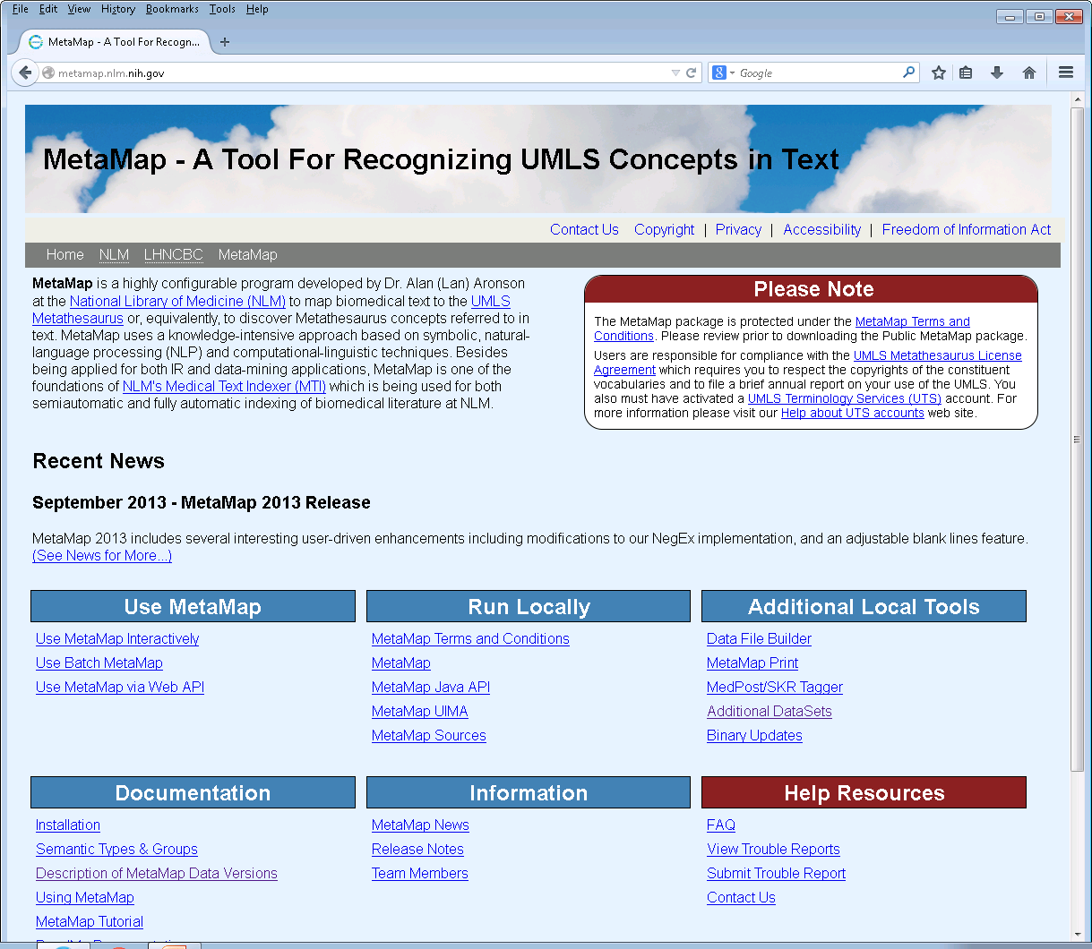
MetaMap Availability: 1
Web access (start here)
http://metamap.nlm.nih.gov
Interactive processing for small pieces of text
Batch (file) processing via Scheduler
Java Web API to Scheduler
All usage requires UMLS license agreement

Slide 45
MetaMap Availability: 2
Local use of MetaMap
Downloadable MetaMap installation
MetaMap Java API
MetaMap UIMA Annotator
MetaMap Sources
Data File Builder
All usage requires UMLS license agreement

Slide 46
Tutorial Outline
Purpose and foundations of MetaMap (Lan)
The MetaMap algorithm (Lan)
Input/output formats (François)
Scenarios (François)
Access methods (Jim)
Case Studies (Jim, Lan)
Future directions (Lan)

Slide 47
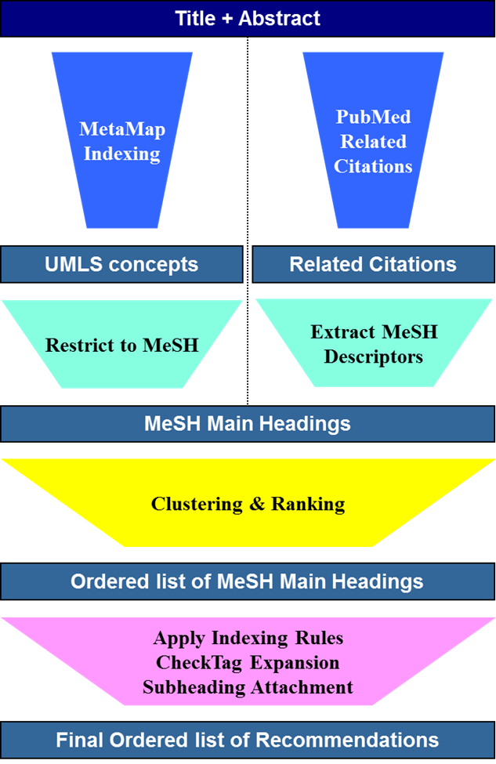
The NLM Medical Text Indexer (MTI)
Product of Indexing Initiative
Assists NLM Indexers
In use since mid-2002
Uses article Title and Abstract
Semi-Automatic MeSH Indexing Recommendations
Performs initial indexing for small subset of journals (MTIFL)
Notes:
General overview of what MTI is and how it is currently being used
-- For Cataloging and HMD we use Title and a combination of the 520 Summary
field and any Library of Congress Subject Headings to make up an “Abstract”
like structure.
-- We have done some full text studies and came up with only slightly better
results than using just the Title and Abstract.

Slide 48
MetaMap Indexing (MMI)
Used for finding UMLS Metathesaurus concepts in text.
Better coverage versus just looking for MeSH Headings
Provides our best indicator for MeSH Headings
Handles spelling variants, abbreviations, and synonym identification. (Handles most British Spellings)
Obstructive Sleep Apnea
Obstructive Sleep Apnoea
OSA (3-ways ambiguous)
Heart Attack
Myocardial Infarction

Slide 49
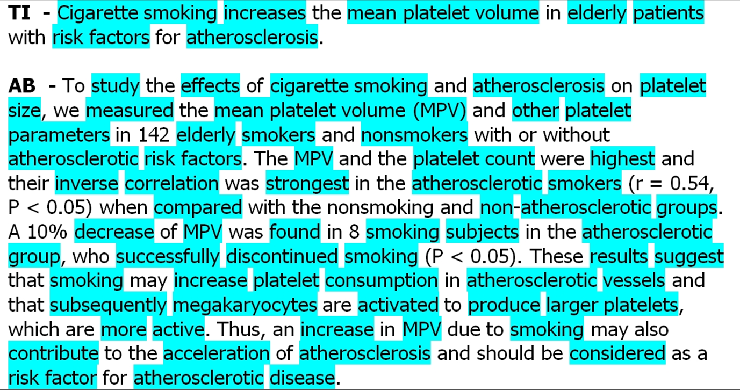
MetaMap Mapping Example
PMID: 1478007 (June 17, 2013)

Slide 50
Restrict to MeSH
Encephalitis Virus, California
ET: Jamestown Canyon virus
ET: Tahyna virus
Inkoo virus
Jerry Slough virus
Keystone virus
Melao virus
San Angelo virus
Serra do Navio virus
Snowshoe hare virus
Trivittatus virus
Lumbo virus
South River virus
ET: California Group Viruses
Allows us to map UMLS concepts to MeSH Headings
Updated with each UMLS release
Extends MMI abilities by mapping nomenclature to MeSH
Restrict to MeSH
Usage requires UMLS license agreement
http://mor.nlm.nih.gov/dnwl/auth/rtm

Slide 51
How MTI Uses MetaMap
Dominate input pathway (weighted 7 – 2 over PRC)
Cast a wide net to identify as many UMLS concepts as possible, while balancing time constraints
metamap –iDN
Ignore Word Order (-i)
All Derivational Variants (-D)
Fielded MMI Output (-N)

Slide 52
Why These Options? -- iD
Text: preventing hemorrhage pre-operatively
No Derivational Variants
812 HAEMORRHAGE NOS (Hemorrhage) [Finding]
Needs both
to find
All Derivational Variants + Ignore Word Order (-iD)
783 Operative haemorrhage (Blood Loss, Surgical) [Pathologic Function]
Example from metamap14 with 2014AA UMLS

Slide 53
Why These Options? -- iD
Text: respirable particulate matter
No Derivational Variants
Nothing for “respirable”
Only needs
-D to find
All Derivational Variants + Ignore Word Order (-iD)
690 C0282636:respiration (Cell Respiration) [Cell Function]
690 C0042497:Respirator, NOS (Mechanical Ventilator) [Medical Device]
690 C0035203:Respiration [Physiologic Function]
690 C0087153:respirator (Ventilator - respiratory equipment) [Medical Device]
690 C1160636:respiration (respiratory gaseous exchange in organisms) [Biologic Function]
Example from metamap14 with 2014AA UMLS

Slide 54
Why These Options? -N
24448992|AA|CAIST|Cilostazol in Acute Ischemic Stroke Treatment|1|5|11|45
24448992|AA|END|early neurological deterioration|1|3|5|32
17285228|MM|429.43|Homocystine|C0019879|[aapp,bacs]|["Homocystine"-ab-3-"Homocysteine","Homocystine"-ab-2-"homocysteine","Homocystine"-ab-1-"Homocysteine","Homocystine"-ti-1-"homocysteine"]| TI;AB|407:12|228:12|74:12|35:12|
D02.886.030.554;D12.125.095.533;D12.125.119.658;D12.125.166.554
Wealth of information available in an easily parsable package
Author defined acronyms/abbreviations
Information on text triggers for each UMLS concept
More compact than XML formatted output
Example from metamap13 with 2013AB UMLS

Slide 55
Why These Options? -N
24448992|AA|CAIST|Cilostazol in Acute Ischemic Stroke Treatment|1|5|11|45
24448992|AA|END|early neurological deterioration|1|3|5|32
Author-defined acronyms/abbreviations
abbreviation (AA)
expansion
number of tokens in the AA
length of the AA
number of tokens in the expansion (white space counts)
length of the expansion
Example from metamap13 with 2013AB UMLS

Slide 56
Why These Options? -N
17285228|MM|429.43|Homocystine|C0019879|[aapp,bacs]|["Homocystine"-ab-3-"Homocysteine","Homocystine"-ab-2-"homocysteine","Homocystine"-ab-1-"Homocysteine","Homocystine"-ti-1-"homocysteine"]|
TI;AB|407:12|228:12|74:12|35:12|
D02.886.030.554;D12.125.095.533;D12.125.119.658;D12.125.166.554
PMID – PubMed Unique Identifier
Example from metamap13 with 2013AB UMLS

Slide 57
Why These Options? -N
17285228|MM|429.43|Homocystine|C0019879|[aapp,bacs]|["Homocystine"-ab-3-"Homocysteine","Homocystine"-ab-2-"homocysteine","Homocystine"-ab-1-"Homocysteine","Homocystine"-ti-1-"homocysteine"]|
TI;AB|407:12|228:12|74:12|35:12|
D02.886.030.554;D12.125.095.533;D12.125.119.658;D12.125.166.554
Path Name – Always “MM”
Example from metamap13 with 2013AB UMLS

Slide 58
Why These Options? -N
17285228|MM|429.43|Homocystine|C0019879|[aapp,bacs]|["Homocystine"-ab-3-"Homocysteine","Homocystine"-ab-2-"homocysteine","Homocystine"-ab-1-"Homocysteine","Homocystine"-ti-1-"homocysteine"]|
TI;AB|407:12|228:12|74:12|35:12|
D02.886.030.554;D12.125.095.533;D12.125.119.658;D12.125.166.554
Score – Relevancy score with results ordered into most relevant to least relevant order.
Example from metamap13 with 2013AB UMLS

Slide 59
Why These Options? -N
17285228|MM|429.43|Homocystine|C0019879|[aapp,bacs]|["Homocystine"-ab-3-"Homocysteine","Homocystine"-ab-2-"homocysteine","Homocystine"-ab-1-"Homocysteine","Homocystine"-ti-1-"homocysteine"]|
TI;AB|407:12|228:12|74:12|35:12|
D02.886.030.554;D12.125.095.533;D12.125.119.658;D12.125.166.554
UMLS Concept Preferred Name
Example from metamap13 with 2013AB UMLS

Slide 60
Why These Options? -N
17285228|MM|429.43|Homocystine|C0019879|[aapp,bacs]|["Homocystine"-ab-3-"Homocysteine","Homocystine"-ab-2-"homocysteine","Homocystine"-ab-1-"Homocysteine","Homocystine"-ti-1-"homocysteine"]|
TI;AB|407:12|228:12|74:12|35:12|
D02.886.030.554;D12.125.095.533;D12.125.119.658;D12.125.166.554
UMLS Concept Unique Identifier
Example from metamap13 with 2013AB UMLS

Slide 61
Why These Options? -N
17285228|MM|429.43|Homocystine|C0019879|[aapp,bacs]|["Homocystine"-ab-3-"Homocysteine","Homocystine"-ab-2-"homocysteine","Homocystine"-ab-1-"Homocysteine","Homocystine"-ti-1-"homocysteine"]|
TI;AB|407:12|228:12|74:12|35:12|
D02.886.030.554;D12.125.095.533;D12.125.119.658;D12.125.166.554
List of Semantic Types
Complete List: http://metamap/SemanticTypesAndGroups.shtml
Example from metamap13 with 2013AB UMLS

Slide 62
Why These Options? -N
17285228|MM|429.43|Homocystine|C0019879|[aapp,bacs]|["Homocystine"-ab-3-"Homocysteine","Homocystine"-ab-2-"homocysteine","Homocystine"-ab-1-"Homocysteine","Homocystine"-ti-1-"homocysteine"]|
TI;AB|407:12|228:12|74:12|35:12|
D02.886.030.554;D12.125.095.533;D12.125.119.658;D12.125.166.554
List of Entry Term Quartets
Entry Term Quartet
"Homocystine"-ab-2-"homocysteine"
"Homocystine" – UMLS Concept Preferred Name
ab – Found in Abstract
2 – Found in section’s second utterance
"homocysteine" – Actual text used for mapping
Example from metamap13 with 2013AB UMLS

Slide 63
Why These Options? -N
17285228|MM|429.43|Homocystine|C0019879|[aapp,bacs]|["Homocystine"-ab-3-"Homocysteine","Homocystine"-ab-2-"homocysteine","Homocystine"-ab-1-"Homocysteine","Homocystine"-ti-1-"homocysteine"]|
TI;AB|407:12|228:12|74:12|35:12|
D02.886.030.554;D12.125.095.533;D12.125.119.658;D12.125.166.554
Location(s) in text where concepts found -- boost scores for TI
TI – Title
AB – Abstract
Example from metamap13 with 2013AB UMLS

Slide 64
Why These Options? -N
17285228|MM|429.43|Homocystine|C0019879|[aapp,bacs]|["Homocystine"-ab-3-"Homocysteine","Homocystine"-ab-2-"homocysteine","Homocystine"-ab-1-"Homocysteine","Homocystine"-ti-1-"homocysteine"]|
TI;AB|407:12|228:12|74:12|35:12|
D02.886.030.554;D12.125.095.533;D12.125.119.658;D12.125.166.554
List of Positional Information Groups [start:length]
Example from metamap13 with 2013AB UMLS

Slide 65
Why These Options? -N
17285228|MM|429.43|Homocystine|C0019879|[aapp,bacs]|["Homocystine"-ab-3-"Homocysteine","Homocystine"-ab-2-"homocysteine","Homocystine"-ab-1-"Homocysteine","Homocystine"-ti-1-"homocysteine"]|
TI;AB|407:12|228:12|74:12|35:12|
D02.886.030.554;D12.125.095.533;D12.125.119.658;D12.125.166.554
List of MeSH Treecodes if UMLS Concept is a MeSH Term
Example from metamap13 with 2013AB UMLS

Slide 66
MMI -- MetaMap13 vs MetaMap14
MetaMap 13:
17285228|MM|429.43|Homocystine|C0019879|[aapp,bacs]|["Homocystine"-ab-3-"Homocysteine","Homocystine"-ab-2-"homocysteine","Homocystine"-ab-1-"Homocysteine","Homocystine"-ti-1-"homocysteine"]|
TI;AB|407:12|228:12|74:12|35:12|D02.886.030.554;D12.125.095.533;D12.125.119.658;D12.125.166.554
MetaMap 14:
17285228|MMI|429.43|Homocystine|C0019879|[aapp,bacs]|["Homocystine"-ab-3-"Homocysteine"-noun-0,"Homocystine"-ab-2-"homocysteine"-noun-0,"Homocystine"-ab-1-"Homocysteine"-noun-0,"Homocystine"-ti-1-"homocysteine"-noun-0]|
TI;AB|407:12;228:12;74:12;35:12|D02.886.030.554;D12.125.095.533;D12.125.119.658;D12.125.166.554
Entry Term Quartet vs Sextet
"Homocystine"-ab-2-"homocysteine"-noun-0
"Homocystine" – UMLS Concept Preferred Name
ab – Found in Abstract
2 – Found in section’s second utterance
"homocysteine" – Actual text used for mapping
------------------------- NEW FIELDS --------------------------
noun – Part of Speech tagging
0 – NegEx Flag (1 – Negated, 0 – Not Negated)
Positional Information is now
contained in a single field.
Examples from metamap13 with 2013AB UMLS and metamap14 with 2014AA UMLS

Slide 67
Why These Options? -- Filtering
Homocystine vs Homocysteine
0000000|MM|424.55|Homocystine|C0019879|[aapp,bacs] |["Homocystine"-ti-1-"Homocystine"]|TI|20:11
0000000|MM|424.55|homocysteine|C0019878|[aapp,bacs]
|["homocysteine"-ti-1-"Homocystine"]|TI|20:11
Borne → Bear
0000000|MM|734.96|Ursidae Family|C0004897|[mamm] |["Bear"-ti-1-"borne"]|TI|32:5
0000000|MM|112.74|Bearing Device Component|C1704689|[medd] |["Bearing"-ti-1-"borne"]|TI|32:5
0000000|MM|112.74|Caliber|C1301886|[qnco] |["Bore"-ti-1-"borne"]|TI|32:5

Slide 68
Case Study: MedDRA Terms in Labels
Taxiarchis Botsis et al. (FDA)
Need to translate the Adverse Reaction section of FDA labels to MedDRA terms
MetaMap restricted to MedDRA with/without VaeTM (Vaccine Adverse Event Text Mining) system
F-measure of 65% or better on small sample using both MetaMap and VaeTM

Slide 69
Case Study: MetaMapped MIMIC II
Richard Osborne, Kevin Cohen (U. Colorado)
Creation of a repository of MetaMap output (XML format) for the MIMIC II database
Development of a Python module to extract information from the XML
Resource for the research community

Slide 70
Case Study: Identifying Novel Associations
David Hanauer et al. (U. Michigan)
Goal to identify novel associations among ICD-9 codes in a large clinical dataset
MetaMap restricted to ICD-9 applied to 1.6 million patient records
Compared with similar results from MEDLINE

Slide 71
Case Study: Vocabulary Construction
Sina Madani et al. (MD Anderson)
Goal of constructing a vocabulary limited to certain semantic types (e.g., disorders) using selected clinical note types (e.g., Discharge Summary) and section headers (e.g., past medical history)
MetaMap results restricted by semantic type are used to provide initial seed data for an IBM tool
Several combinations of MetaMap options have been explored

Slide 72
Case Study: Drug Indications KB
Ritu Khare et al. (NCBI)
Use of MetaMap and human annotators to extract disease mentions from Indications and Usage section of FDA labels
MetaMap options
Candidates with alternative mapping construction
Optional term processing
Semantic categories (Disorder group without Finding)
Vocabularies (SNOMED-CT and MeSH)
WSD

Slide 73
Tutorial Outline
Purpose and foundations of MetaMap (Lan)
The MetaMap algorithm (Lan)
Input/output formats (François)
Scenarios (François)
Access methods (Jim)
Case Studies (Jim, Lan)
Future directions (Lan)

Slide 74
Future MetaMap Development (1/2)
Extend mapping construction to handle conjunctions
Explore the use of ranking strategies to improve MetaMap’s accuracy
Improve disambiguation quality with additional WSD algorithms
Augment tokenization with recognition of chemical names, bibliographic references, numeric quantities, etc.

Slide 75
Future MetaMap Development (2/2)
Enhance processing of short words, including acronyms/abbreviations
Handle space/hyphen/null alternation (e.g., breast feed/breast-feed/breastfeed) more reliably
Explore technical enhancements in graceful back-off for long phrases
Incorporate user-suggested improvements

Slide 76
Web Pointers*
2010 AMIA MetaMap Tutorial (T29: UMLS Concept Identification using the MetaMap System) slides available at: http://ii.nlm.nih.gov/Publications/index.shtml/
Indexing Initiative Home Page: http://ii.nlm.nih.gov/ (interactive/batch MetaMap, MTI, SemRep, …)
MetaMap Portal: http://metamap.nlm.nih.gov/ (downloadable binary version of Prolog/C implementation, API, …)
* All MetaMap access requires a UMLS license: http://www.nlm.nih.gov/research/umls/license.html
Start Here!

Slide 77
Tutorial Faculty Pointers
Alan (Lan) R. Aronson: alan@nlm.nih.gov
François-Michel Lang: flang@mail.nih.gov
James G. Mork: mork@nlm.nih.gov

Slide 78
Comments or Questions?
Please contact us if you have questions, or are having problems running MetaMap.
A lot of changes to MetaMap are due to requests from users!
metamap@nlm.nih.gov

Slide 80
Candidates vs. Mappings
Candidates: intermediate results
Candidates are not displayed by default in MM14
Often contain many bad matches among the good ones (similar to results of Browse mode vs. Semantic mode)
Should be used judiciously/selectively and only when mappings are found to be inadequate
Use -c (--show_candidates) to include candidates
Mappings: MetaMap’s final answers to text input

Slide 81
Candidates vs. Mappings Example
Phrase: heart attack
Meta Candidates (Total=6; Excluded=0; Pruned=0; Remaining=6)
1000 Heart attack (Myocardial Infarction) [dsyn]
861 Heart [bpoc]
861 Attack, NOS (Onset of illness) [fndg]
861 Attack (Attack device) [medd]
861 attack (Attack behavior) [socb]
861 Heart (Entire heart) [bpoc]
861 Attack (Observation of attack) [fndg]
827 Attacked (Assault) [inpo]
Meta Mapping (1000):
1000 Heart attack (Myocardial Infarction) [dsyn]

