Slide 1
The NLM Indexing Initiative:
Current Status and Role in Improving Access to Biomedical Information
A Report to the Board of Scientific Counselors
April 5, 2012
Alan R. Aronson (Principal Investigator)
James G. Mork
François-Michel Lang
Willie J. Rogers
Antonio J. Jimeno-Yepes
J. Caitlin Sticco

Slide 2
Outline
Introduction [Lan]
MetaMap [François]
The NLM Medical Text Indexer (MTI) [Jim]
Availability of Indexing Initiative Tools [Willie]
Research and Outreach Efforts [Antonio, Caitlin, Lan]
Summary and Future Plans [Lan]
Questions

Slide 3
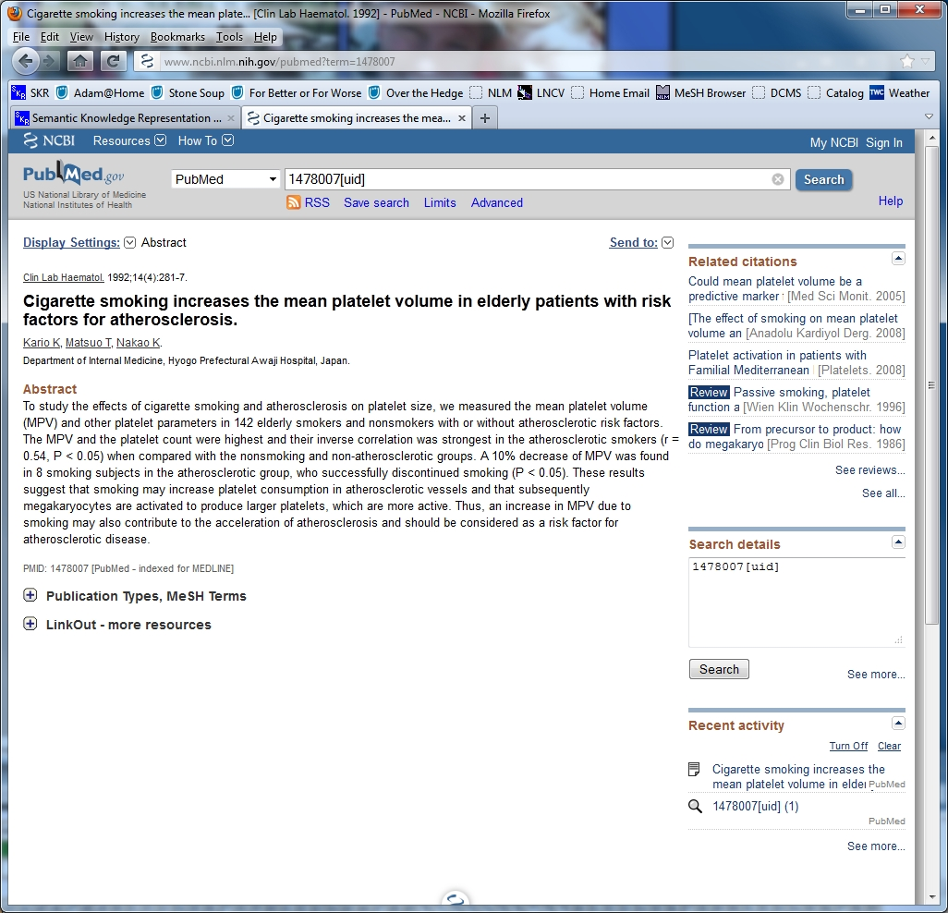
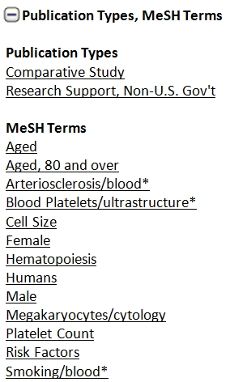
MEDLINE Citation Example

Slide 4
Introduction - Growth in MEDLINE
* MEDLINE Baseline less OLDMEDLINE and PubMed-not-MEDLINE

Slide 5
The NLM Indexing Initiative (II)
The need for MEDLINE indexing support
  Increasing demand/costs for indexing in light of
  Flat budgets
One solution: creation of the NLM Indexing Initiative in 1996 resulting in NLM Medical Text Indexer (MTI)
The Indexing Initiative today:
  Identification of problems or needs followed by subsequent research
  Production of MTI recommendations and other indexing
  Opportunities for training and collaboration

Slide 6
Medical Informatics Training Program Fellows
Antonio J. Jimeno-Yepes, Postdoctoral Fellow: 2010-
J. Caitlin Sticco, Library Associate Fellow: 2011-
Bridget T. McInnes, Postgraduate Fellow: 2008
PhD in 2009
Current affiliation: Securboration
Aurélie Névéol, Postdoctoral Fellow: 2006-2008
Current affiliation: NCBI
Marc Weeber, Postgraduate Fellow: 2000
PhD in 2001
Current affiliation: Personalized Media

Slide 7
II Highlights from 2008
Subheading attachment (Aurélie Névéol)
Full text experiments (Cliff Gay)
Initial Word Sense Disambiguation (WSD) method based on Journal Descriptor (JD) Indexing (Susanne Humphrey)
  The Journal of Cardiac Surgery has JDs
  ‘Cardiology’ and
  ‘General Surgery’

Slide 8
II Accomplishments since 2008
The inauguration of MTI as a first-line indexer (MTIFL)
Downloadable releases of MetaMap, most recently for Windows XP/7
Significant improvement in MTI’s performance due to
  Technical improvements to MetaMap and MTI, but even more to
  Close collaboration with LO Index Section
More WSD methods with better performance
The development of Gene Indexing Assistant (GIA)

Slide 9
Outline
Introduction [Lan]
MetaMap [François]
The NLM Medical Text Indexer (MTI) [Jim]
Availability of Indexing Initiative Tools [Willie]
Research and Outreach Efforts [Antonio, Caitlin, Lan]
Summary and Future Plans [Lan]
Questions

Slide 10
MetaMap - Overview
Purpose
Foundations
Complexity
Processing Example
Challenge of UMLS Metathesaurus Growth
Significant New Features
Notes:
First, I will present MetaMap’s purpose and some of its foundations.
Next, give some examples of the complexity of MetaMap’s data and processing.
Then, touch on the challenges of processing an ever-growing UMLS
and outline one strategy that we’ve employed to deal with the growth of the UMLS.
Finally, conclude by explaining some significant new features
we’ve recently added to MetaMap.

Slide 11
MetaMap - Purpose
Named-entity recognition
Identify UMLS Metathesaurus concepts in text
Important and difficult problem
MetaMap’s dual role:
  Local: Critical component of NLM’s Medical Text Indexer (MTI)
  Global: Pre-eminent biomedical concept-identification application
Notes:
…
Concept identification is an important and difficult problem,
in fact, one that is likely to remain an active research area for the foreseeable future.
But it’s a problem that MetaMap has done a pretty good job at.
As a measure of our success, we can point to MetaMap’s dual role
inside and outside the Library.
Locally, MetaMap *IS* a critical component of the library’s Medical Text Indexer MTI, which Jim will talk about,
and
Globally, MetaMap has a very active life of its own as a standalone application,
and has established itself as A pre-eminent tool for biomedical concept identification.
We can gauge MetaMap’s popularity in a couple ways:
First, is the number of MetaMap users throughout the world,
and Willie will present some statistics about MetaMap use in his presentation.
We can also see how MetaMap is becoming more and more popular
by tracking references to MetaMap in the biomedical literature.

Slide 12
“MetaMap” in PubMed Central
49
53
43
40
Notes:
This graph shows the number of appearances of the word “MetaMap” in articles in PubMed Central over the past 15 years.
We can see from this graph how over the years,
references to MetaMap have grown more frequent in the biomedical literature,
as more and more research projects cite MetaMap and compare their results to MetaMap’s.
Specifically, In each of the past four years,
there have been at least 40 references to MetaMap in PubMed Central articles.
Let’s look next at some of the foundations of MetaMap.

Slide 13
MetaMap - Foundations
Knowledge-intensive approach
Natural Language Processing (NLP)
Emphasize thoroughness over efficiency
However…efficiency is still important!
Notes:
Very briefly, some of MetaMap’s foundations are
* a knowledge-intensive approach to processing text, and
* use of Natural Language Processing
It’s certainly possible to do a quick-n-dirty job of concept identification
simply by brute-force keyword searching and the like,
but our processing is considerably more complex.
…
As the Metathesaurus has grown, MetaMap’s efficiency has decreased,
and I’ll be talking about how we’ve handled that growth later in the presentation.
Let’s take a look now at some of the complexity we encounter.

Slide 14
Complexity of Language - Synonymy
Heart Attack
Myocardial infarction
Attack coronary
Heart infarction
Myocardial necrosis
Infarction of heart
AMI
MI
C0027051: Myocardial Infarction
Notes:
Synonymy essentially means many different ways of saying the same thing.
For example, the strings on the left all denote the concept whose preferred name is Myocardial Infarction.
Synonymy is a GOOD THING;
it’s one of the many beneficial features of the Metathesaurus
and contributes to its richness as a knowledge source.
There are actually 66 English strings that denote the concept “Myocardial Infarction”
but that is by no means the concept with the most synonyms:
There are 138 concepts that are denoted by over 100 strings
and 3 concepts that are denoted by over 300 strings.
Another complexity of natural language that we encounter is AMBIGUITY.

Slide 15
Complexity of Language - Ambiguity
C0009264: Cold Temperature
cold C0234192: Cold Sensation
C0009443: Common Cold
Ambiguity resolved by Word Sense Disambiguation
Notes:
Synonymy is the phenomenon of having many different ways of saying the same thing.
Ambiguity is sort of the flip side – it’s the phenomenon of the same thing having many different meanings.
An example we like to use, because it’s concise and compelling, is “cold”,
which denotes the three concepts Cold Temperature, Cold Sensation and the Common Cold.
Although ambiguity is pervasive in any analysis of language,
it is most definitely not a beneficial feature, but rather a problem we have to solve.
In fact, ambiguity is probably MetaMap’s biggest problem.
One way we try to deal with ambiguity is Word Sense Disambiguation,
which Antonio will talk about in his section.
Now that we’ve touched briefly on some of the complexities
inherent in working with natural language and the UMLS,
let’s look next at an example of MetaMap’s processing.

Slide 16
MetaMap - Processing Example
C0180860: Filters [mnob]
C0581406: Optical filter [medd]
C1522664: filter information process [inpr]
C1704449: Filter (function) [cnce]
C1704684: Filter Device Component [medd]
C1875155: Filter - medical device [medd]
Inferior vena caval stent filter (PMID 3490760)
Candidate Concepts:
909 C0080306: Inferior Vena Cava Filter [medd]
804 C0180860: Filter [mnob]
804 C0581406: Filter [medd]
804 C1522664: Filter [inpr]
804 C1704449: Filter [cnce]
804 C1704684: Filter [medd]
804 C1875155: FILTER [medd]
717 C0521360: Inferior vena caval [blor]
673 C0042460: Vena caval [bpoc]
637 C0038257: Stent [medd]
637 C1705817: Stent [medd]
637 C0447122: Vena [bpoc]
Metathesaurus String
UMLS Semantic Type
Metathesaurus Concept Unique Identifier (CUI)
MetaMap Score (≤ 1000)
C0038257: Stent, device [medd]
C1705817: Stent Device Component [medd]
Notes:
This is an example of the first part of MetaMap human-readable output,
which a list of the Metathesaurus concepts that MetaMap identified
from the input text “inferior vena caval stent filter”, which is the title of a MEDLINE citation.
*Identify output fields.*
1000 is PERFECT SCORE.
Ambiguity of “Filter” – these are the Preferred Names;
The concepts have Semantic Types
Manufactured Object, Medical Device,
Intellectual Product, and Conceptual Entity.
Ambiguity of “Stent” – these are the Preferred Names.
These concepts are MetaMap’s intermediate results; they are not MetaMap’s final answer.
MetaMap’s final answer are its final mappings, which we’ll look at next.
Each mapping is a subset of the set of candidates,
and represents MetaMap’s best interpretation of the input phrase.
In this case, MetaMap’s final answer, its final mappings, are formed from
three of the concepts: Highlight IVCF + two “Stent” concepts.

Slide 17
MetaMap - Processing Example
Inferior vena caval stent filter
Final Mappings (subsets of candidate sets):
Meta Mapping (911)
909 C0080306: Inferior Vena Cava Filter [medd]
637 C1705817: Stent [medd]
Meta Mapping (911):
909 C0080306: Inferior Vena Cava Filter [medd]
637 C0038257: Stent [medd]
Notes:
Metamap’s final mappings are sets of candidates
that represent MetaMap’s best interpretation of the input text.
One takeaway here is that each mapping is a subset of the set of candidate concepts,
which means that the number of possible mappings
is exponential in the number of candidates.
Specifically, if we have N candidates, the number of possible mappings is equal to 2^N.
I want to look next at the growth of the Metathesaurus.

Slide 18
Metathesaurus String Growth 1990-2011
8.86M
M
I
L
L
I
O
N
S
80x Growth:
>23%/year
> 54x Growth
MEDCIN & FMA
MEDCIN & FMA
SNOMEDCT
SNOMEDCT
162K
Notes:
X axis represents UMLS releases from 1990 to the present.
Y axis represents millions of strings
A few things to notice about this graph:
First, there are two big spikes in 2004 and 2008;
those are from the addition to the Metathesaurus
of SNOMEDCT in 2004 and of MEDCIN and FMA in 2008.
(MEDCIN medical terminology encompasses symptoms, history, physical examination, tests, diagnoses, and therapies.)
In !990, which marks the very beginning of The MetaMap Era (!),
there were only 162K strings in the Metathesaurus.
Last year, in 2011, we topped out at nearly 9 million.
That represents overall growth of over 54 fold.
Results in significantly degraded computational efficiency!
I want to show next a specific example of the kind of problem that Metathesaurus growth has presented.

Slide 19
An Especially Egregious Example
Phrase from PMID 10931555
protein-4 FN3 fibronectin type III domain GSH glutathione GST glutathione S-transferase hIL-6 human interleukin-6 HSA human serum albumin IC(50) half-maximal inhibitory concentration Ig immunoglobulin IMAC immobilized metal affinity chromatography K(D) equilibrium constant
Extreme, but not atypical
MetaMap identifies 99 concepts
Mappings are subsets of candidates: Up to 2⁹⁹ mappings
Would require 10²¹ TB of memory!
Algorithmic Solutions
Notes:
The text in yellow is the most problematic text for MetaMap to analyze
in all of MEDLINE.
Perfect storm: Parser and too many concepts.
Causes MetaMap to run for many hours and/or run out of memory.
Extreme, but not atypical.
10^21 terabytes is many billions of times more computer memory than exists in the entire world!
So this problem is clearly not tractable.
The report describes several algorithmic solutions that we’ve implemented,
and I’ll present one of the solutions now.

Slide 20
Solution - Pruning the Candidate Set
Problems:
  MetaMap runs far too long and/or runs out of memory
  MTI’s overnight processing did not complete
Allow MetaMap to generate (perhaps suboptimal) results
  in reasonable amount of time
  without exceeding memory limits
Solution: Prune out least useful candidates
Default maximum # of candidates: 35/phrase (heuristic)
Pruning under user control
Fewer candidates → Many fewer mappings
Inferior vena caval stent filter
909 C0080306: Inferior Vena Cava Filter [medd]
804 C0180860: Filter [mnob]
804 C0581406: Filter [medd]
804 C1522664: Filter [inpr]
804 C1704449: Filter [cnce]
804 C1704684: Filter [medd]
804 C1875155: FILTER [medd]
717 C0521360: Inferior vena caval [blor]
673 C0042460: Vena caval [bpoc]
637 C0038257: Stent [medd]
637 C1705817: Stent [medd]
637 C0447122: Vena [bpoc]
Notes:
Prune out or eliminate the weakest candidates, i.e.,
those candidates least likely to participate in final mappings.
Now let’s look at a specific example of how candidate pruning actually works.
I’ll bring back the set of candidate concepts that we saw a few slides back,
identified from “inferior vena caval stent filter”.
In real life MetaMap, because there are only a dozen concepts here,
the pruning algorithm would not normally be invoked.
BUT if we artificially force pruning algorithm to apply in this case,
it would prune out these concepts,
because all of them have a higher-scoring concept that covers the same portion of the input text.
We can see that all these concepts are covered by the first concept, which has a higher score.
Notice that the two “Stent” concepts are preserved!
Experimentally, we’ve determined that 35 concepts is about as many as we can handle
User control
How has this helped?
Now, let’s look at the results of our algorithmic improvements.

Slide 21
Results of Algorithmic Improvements
2010 MEDLINE baseline: 146 troublesome citations
Original runtime > 12 hours per citation
Improved runtime ~ 12.3 seconds per citation
350,000% improvement for problematic citations
Efficiency improvements across MEDLINE baseline:
2004 MEDLINE Baseline (12.5M citations): 6 months
2012 MEDLINE Baseline (20.5M citations): 8 days
Notes:
…
…
Just to clarify: We haven’t achieved a 350,000% speedup of MetaMap in general;
just on those problem citations.
However, the overall efficiency improvement can be appreciated this way:
*MEDLINE*
I’d like to talk next about several significant functionality enhancements we’ve made to MetaMap,
all of which were delivered as solutions to specific problems raised by our users.

Slide 22
Significant New MetaMap Features
Solutions for problems
Default output difficult to post-process:
  XML output
MetaMap originally developed for literature, not clinical:
  Wendy Chapman’s NegEx (negation detection)
  User-Defined Acronyms
Notes:
First, we saw a few slides back an example of MetaMap’s human-readable output.
Most MetaMap users want to slice-n-dice MetaMap output,
and although that’s doable with human-readable output, it’s not straightforward,
because human-readable output does not readily lend itself to automated post processing.
So, to simplify the task of postprocessing MetaMap output
we delivered XML output, which is a well understood standard that is easy to post-process.
As we extend MetaMap’s range beyond the biomedical literature to include clinical text as well,
we added two features to MetaMap specifically targeted at better handling clinical text.
…
NegEx is specifically targteted to clinical text…
Before I explain User-Defined Acronyms, and how they help MetaMap better analyze clinical text,
I want to show how acronyms typically appear in the literature.

Slide 23
Literature: Author-Defined Acronyms
Acronyms often defined by authors in literature:
Trimethyl cetyl ammonium pentachlorphenate (TCAP) and fatty acids as antifungal agents.
Reticulo-endothelial immune serum (REIS) in a globulin fraction
The bacteriostatic action of isonicotinic acid hydrazid (INAH) on tubercle bacilli
the interstitial latero-dorsal hypothalamic nucleus (ILDHN) of the female guinea pig
The adrenocorticotropic hormone (ACTH) of the anterior pituitary.
MetaMap replaces acronyms’ short form with their long form
Notes:
In the biomedical literature, acronyms are usually well defined.
Typically, the LONG FORM, or the expansion of the acronym appears first,
followed by the SHORT FORM, or the acronym itself, in parentheses.
It’s a very productive paradigm, and AUTHOR-DEFINED acronyms appears all over the literature.
In fact, when we ran MetaMap’s acronym-detection logic over the entire 2011 MEDLINE Baseline,
we found well over ten million of these.
When MetaMap encounters a defined acronym, it will remember the acronym,
and replace subsequent occurrences the short form with its long form before analyzing the text.
If “ACTH” is encountered later in the same input, MetaMap
Remembers that ACTH means “adrenocorticotropic hormone”, and
Replaces the short form of the acronym with its long form, its expansion
and apply the concept-identification logic to the long form.
Now, let’s contrast the appearance of acronyms in the literature
with how they typically appear in clinical text.

Slide 24
Clinical Text: Undefined Acronyms
Acronyms rarely defined in clinical text:
He underwent a CABG and PTCA in 2008.
EKGs show a RBBB with LAFB with 1st AV block
Sequential LIMA to the diagonal and LAD and sequential SVG to the PLB and PDA and SVG to IM grafts were placed
status post CABG with a patent LIMA to LAD and SVG to D1 patent
treatment for PTLD with Rituxan versus CHOP
MetaMap users can define undefined acronyms
Allows customizations tailored to specific needs
post-transplantation lymphoproliferative disorder
cyclophosphamide, hydroxydaunomycin, Oncovin, and prednisone
Notes:
In clinical text, however, acronyms are not nearly so well behaved,
because they typically appear undefined, that is, without their expansions.
And for two reasons:
The target audience presumably knows the acronyms, and
Physicians don’t take the time to enter that much text into their EMR systems.
And who can blame them? What would *you* rather type if you were in a hurry?
These short forms, or these long forms
Which requires 14x as much typing!
Having acronyms not defined in text leads to TWO POSSIBLE PROBLEMS:
The short form of the acronym is not in the Metathesaurus, in which case you’ll get nothing back
or, what’s even worse
(2) The short form *IS* in the Metathesaurus, but denotes a concept that is inappropriate for your specific domain.
In either case, MetaMap users can solve both those problems
by defining their own acronyms,
which allows customizing MetaMap to a user’s particular needs.
Now let’s look at an example of what can happen if the Metathesaurus contains a domain-inappropriate definition.

Slide 25

User-Defined Acronyms (UDAs)
Customize UDAs for radiology domain:
CAT | Computerized Axial Tomography
PET | Positron Emission Tomography
Otherwise…………………
C0031268: Pet (Pet Animal) [Animal]
C1456682: Pets (Pet Health) [Group Attribute]
C0007450: Cat (Felis catus) [Mammal]
C0325090: Cat (Felis silvestris) [Mammal]
C0524517: Cat (Genus Felis) [Mammal]
C0325089: cats (Family Felidae) [Mammal]
Notes:
First, notice that in the title of the slide, “UDAs” is not a user-defined acronym but an author-defined acronym!
…
To summarize: user-defined acronyms enable users to customize MetaMap
not only to specific DOMAINS (e.g., radiology),
but even to specific SITES, so MetaMap can handle a particular hospital’s local lingo.
And that concludes our whirlwind tour of MetaMap.
The full report goes into a great deal more detail,
especially about the efficiency improvements and functionality enhancements.
And with that, I will turn the floor over to Jim.

Slide 26
Outline
Introduction [Lan]
MetaMap [François]
The NLM Medical Text Indexer (MTI) [Jim]
Availability of Indexing Initiative Tools [Willie]
Research and Outreach Efforts [Antonio, Caitlin, Lan]
Summary and Future Plans [Lan]
Questions

Slide 27
The NLM Medical Text Indexer (MTI)
Overview
Uses
MTI as First-Line Indexer (MTIFL)
Performance

Slide 28
MTI - Overview
Summarizes input text into an ordered list of MeSH Headings
In use since mid-2002
Developed with continued Index Section collaboration
Uses article Title and Abstract
Provides recommendations for 96% of indexed articles
Indexer consulted for 50% of indexed articles
Notes:
Highlight Index Section support
Explain why only 50%

Slide 29
MTI Usage

Slide 30
MTI - Uses
Assisted indexing of Index Section journal articles
Assisted indexing of Cataloging and History of Medicine Division records
Automatic indexing of NLM Gateway meeting abstracts
First-line indexing (MTIFL) since February 2011
Also available to the Community
  45,000 requests (2011)
Notes:
Highlight Index Section support
MTIFL
NLM Gateway now gone away

Slide 31
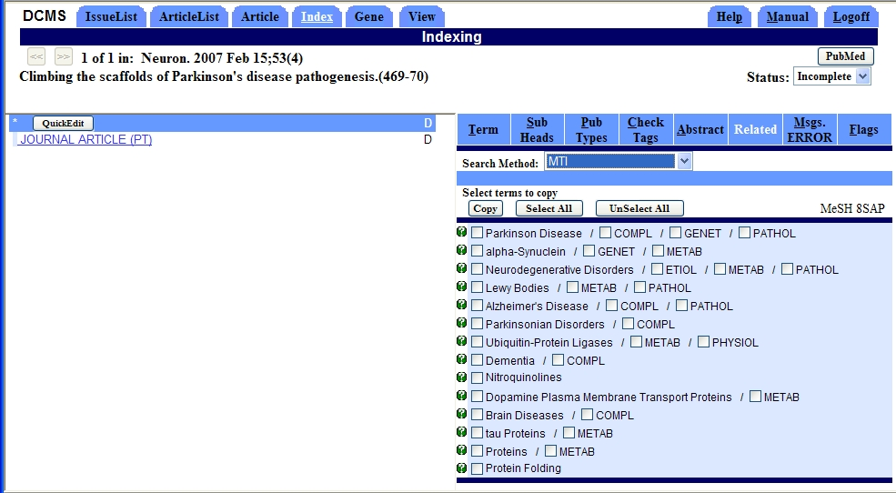
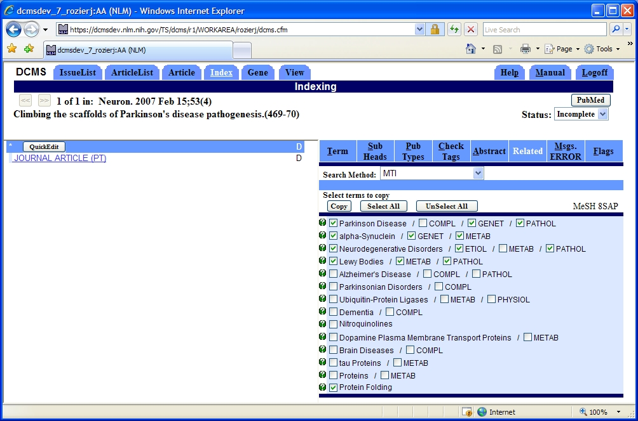
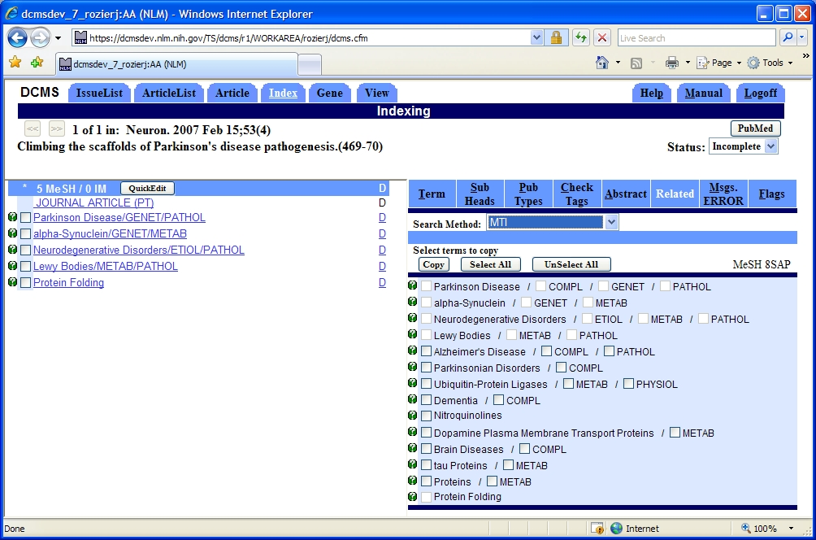
Data Creation and Management System

Slide 32
MTI - Uses
Assisted indexing of Index Section journal articles
Assisted indexing of Cataloging and History of Medicine Division records
Automatic indexing of NLM Gateway meeting abstracts
First-line indexing (MTIFL) since February 2011
Also available to the Community
  45,000 requests (2011)
Notes:
EXTENSIBLE

Slide 33
MTI
MetaMap Indexing – Actually found in text
Restrict to MeSH – Maps UMLS Concepts to MeSH
PubMed Related Citations – Not necessarily found in text
Notes:
MetaMap identifies all of the UMLS concepts it can find in the article providing us with high confidence in terms
Restrict to MeSH then gives us mappings from the UMLS concepts to MeSH terms

Slide 34
PubMed Query Example

Slide 35
MTI
MetaMap Indexing – Actually found in text
Restrict to MeSH – Maps UMLS Concepts to MeSH
PubMed Related Citations – Not necessarily found in text
Received 2,330 Indexer Feedbacks
Incorporated 40% into MTI
March 20, 2012
Hibernation should only be indexed for animals, not for "stem cell hibernation"
Clove (spice) should not be mapped to the verb "cleave"
Notes:
PubMed Related Citations uses same technology as related articles in PubMed
Explain that the algorithm uses words in the title and abstract to compute relatedness
Talk about machine learning (Antonio) and subheading attachment (Aurelie) briefly
for machine learning use Turkey example and mention that Antonio will discuss in more details
for subheading attachment – we do it and it performs well.
Indexer feedback contributes to Post-processing rules

Slide 36
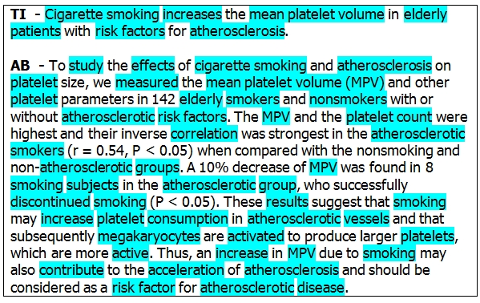
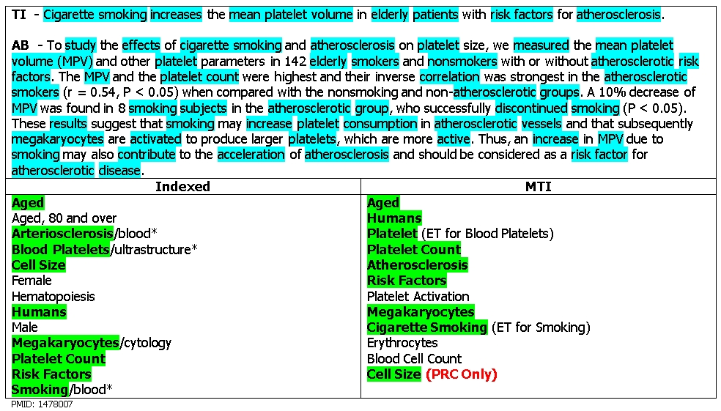
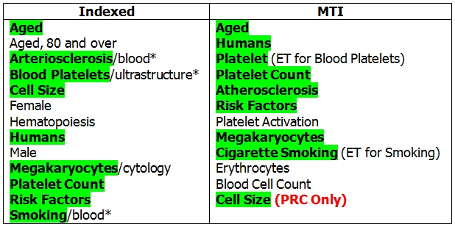
MTI - Example
Notes:
Top part represents what MetaMap identified (highlighted)
Bottom right– MTI recommendations
Bottom left– actual indexing
Green is good!!

Slide 37

MTI as First-Line Indexer (MTIFL)
Indexing Displays in PubMed as Usual
Indexing Displays in PubMed as Usual
MTI
Processes/
Recommends MeSH
Reviser
Reviews
Selects
Adjusts
Approves
MTI
Processes/
Recommends MeSH
Reviser
Reviews
Selects
Adjusts
Approves
23 MEDLINE Journals
Indexer
Reviews
Selects
“Normal”
MTI Processing
Indexer
Reviews
Selects
Notes:
Small percentage of journals capable of MTIFL
Never fully replace Indexers – this allows MTI to handle the “easy” indexing
Freeing Indexers up to handle more complex and interesting articles.
Susan Roy – Library Associate Fellow

Slide 38
MTI as First-Line Indexer (MTIFL)
Indexing Displays in PubMed as Usual
Indexing Displays in PubMed as Usual
MTI
Processes/
Indexes MeSH
Reviser
Reviews
Selects
Adjusts
Approves
MTI
Processes/
Indexes MeSH
Reviser
Reviews
Selects
Adjusts
Approves
23 MEDLINE Journals
Index Section
Compares MTI and Reviser Indexing
MTIFL
MTI Processing
Indexer
Reviews
Selects
Notes:
Small percentage of journals capable of MTIFL
Never fully replace Indexers – this allows MTI to handle the “easy” indexing
Freeing Indexers up to handle more complex and interesting articles.
Susan Roy – Library Associate Fellow

Slide 39
MTIFL
Experiments in 2010 led by Marina Rappaport
  Microbiology, Anatomy, Botany, and Medical Informatics journals
Initial experiment involved both Indexers and MTI
  Provided baseline timings and performance
  Identified challenges (and opportunities)
    Publication Types
    Chemical Flags
    Functional annotation of genes
}
Manually added by indexer
Notes:
Publication Types – characterize what an article is about
Clinical Trial
Clinical Trial, Phase I
Database
Caitlin Sticco – Gene Indexing Assistant

Slide 40
MTIFL
Follow-on experiments focused on reducing MTI revision time:
  Reduce the number of MTI indexing terms
  Focus on journals with few/no Gene Annotation or Chemical Flags
MTI revision time 2.04 minutes faster than Indexer revised time (10.01 minutes vs 12.05 minutes)
Pilot project started with 14 journals, expanded to 23 in 2011
Notes:
Removal of MHs was slower because Reviser had to stop and think about the term whereas adding a missing
MH was almost instantaneous because they new what was missing.

Slide 41
MTI - How are we doing?
Fruition of 2011 Changes
Focus on Precision versus Recall

Slide 42
Outline
Introduction [Lan]
MetaMap [François]
The NLM Medical Text Indexer (MTI) [Jim]
Availability of Indexing Initiative Tools [Willie]
Research and Outreach Efforts [Antonio, Caitlin, Lan]
Summary and Future Plans [Lan]
Questions

Slide 43
Availability of Indexing Initiative Tools
Remote Access
  Web
  API
Local Installation
  Linux
  Mac OS/X
  Windows XP/7
Notes:
Hello, I’m Willie Rogers and I’ll be talking about ways users can get access to the indexing initiative programs MetaMap and MTI.
In the past, users were asking for the ability to use MetaMap and MTI for inclusion in their own research, to compare their systems against ours, or for other reasons. We have tried to keep up with this demand by providing various ways to access our tools as technology and demand have evolved.
Initially, we provided remote access through our web INTERFACE, then added an API so users could call our SERVICES through their own programs. Eventually, it became clear that we had a set of users who could not send their data to us for processing because of the sensitive nature of their data and were requesting the ability to run our tools on their own computers. Technology finally caught up with us and we were able to provide the same MetaMap program that we use internally as a downloadable package for our users. I’ll expand on each of these access methods.

Slide 44
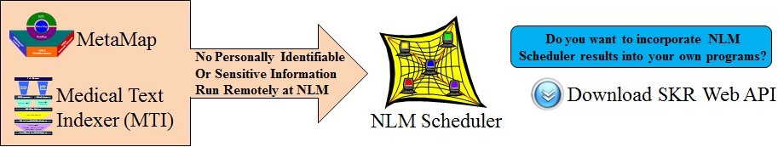
Remote Access
Interactive
  Small input data (for testing, etc.), immediate results
Batch
  Large input data processed using a large pool of computing resources
Notes:
Both MetaMap and MTI are available for remote access both interactively and in batch.
The interactive interface allows a user to experiment with small amounts of input data, trying out various options and receiving the results immediately. Allowing the user to see if the program is providing the information they need. If satisfied, the user can run larger sets of data in our batch mode which uses a cluster of LHC computers for efficient processing, notifying the user when each set completes.
Our interactive and batch services are available through our web site and from within the user’s own programs via our API.

Slide 45
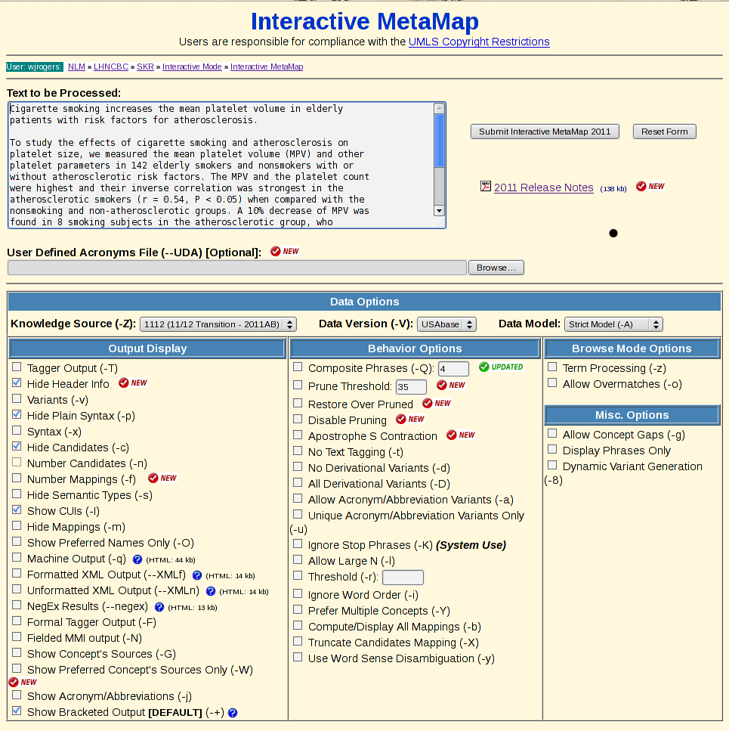
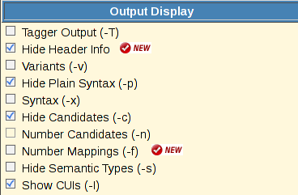
Notes:
Here is an example of using the Web INTERFACE, in this case accessing MetaMap using the Interactive form. The user fills in the text box with his input, sets the desired options, and then submits the request for processing.

Slide 46
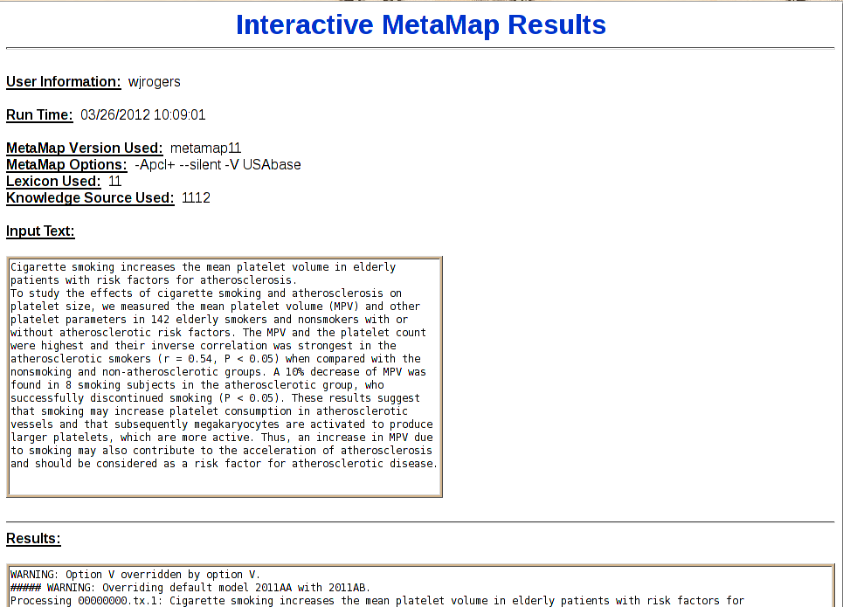
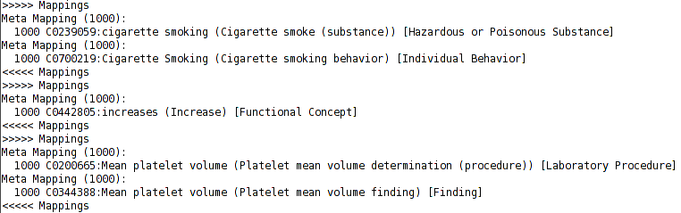
Notes:
In a few seconds the user receives output similar to this: [see slide] In most cases, remote access may be all that most users would want.
For other users that have may have sensitive input data or want to use Knowledge Sources other than the UMLS, or simply want to run on their own computers, we have the locally installable MetaMap.

Slide 47
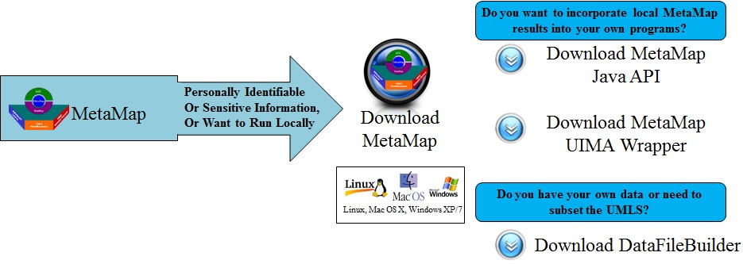
Local Installation of MetaMap
Notes:
The local installation of MetaMap allows users to run MetaMap on their own computers. It is currently available for Linux, Mac OS/X, and most recently Windows XP/7. It is useful for groups that have sensitive information, such as Personally Identifiable Information allowing them to MetaMap in an environment they can control.
Another advantage to the locally installed version of MetaMap is that users can use a custom views of the UMLS with MetaMap, or create their own set of data for MetaMap by using our Data File Builder program which I’ll be discussing in a few minutes…
Another way for users to integrate MetaMap in their local applications is to use the UIMA wrapper we developed.

Slide 48
MetaMap as a UIMA Component
Allows MetaMap to be used as an UIMA “annotator” component.
UIMA - Unstructured Information Management Architecture
a component-based software for the analysis of unstructured information.
Named
Entity
Recognizer
POS
Tagger
Named
Entity
Recognizer
Relation
Extractor
Input
Text
POS
Tagger
Parser
Relation
Extractor
Tokenizer
Parser
Tokenizer
Relations
Notes:
UIMA, or the Unstructured Information Management Architecture is a component software for the analysis of unstructured information. It allows one to bring various pre-built components together to perform a specific task. Shown here is a typical UIMA pipeline were input text is pipe to various components, each extracting features and sending the features to the next component. In this example we wish to extract relations from the input text using a relation extractor. In order to properly recognize relations in the text the extractor needs the output of a Named Entity Recognizer. Recognizer needs a parser which needs a Part-of-speech tagger. The Tagger requires a Tokenizer to tokenize the input text.
We have created a wrapper for MetaMap, TRANSFORMING METAMAP INTO A UIMA COMPONENT, that allows it to be used as a “annotator” component of such pipeline. In the case shown, MetaMap REPLACES several of the components OF THE ORIGINAL PIPELINE…

Slide 49
MetaMap as a UIMA Component
Allows MetaMap to be used as an UIMA “annotator” component.
UIMA - Unstructured Information Management Architecture
a component-based software for the analysis of unstructured information.
Input
Text
MetaMap
Relation
Extractor
Relations
Notes:
In this case MetaMap tokenizes, parses, and extracts the named entities for the relation extractor. Because MetaMap is available as a UIMA component it can be added as resource for a much larger system, new or pre-existing.

Slide 50
UIMA-compliant NLP Toolkits
A number of NLP toolkits that are UIMA compliant
  OpenNLP
  clinical Text Analysis and Knowledge Extraction System (cTAKES)
  OpenPipeline
Notes:
A number of Natural Language Processing toolkits have been developed using UIMA including: Open NLP, cTAKES, and OpenPipeline. Anyone using these or other UIMA based toolkits can use MetaMap using the UIMA wrapper.

Slide 51
Data File Builder
Provides the ability to create specialized data models for MetaMap:
UMLS augmented with user data
UMLS subsets
Independent knowledge sources
  Should have notion of concept, synonymy
  Ontologies
  Local Thesauri
  Other Knowledge Sources
Notes:
As Francois noted earlier, MetaMap normally identifies UMLS concepts in text.
In some cases, a user may want to map entities that are not represented in the UMLS and they need to augment the UMLS with their own data.
Or, because of license restrictions or a desire to focus on a specific vocabulary, the user wants to use a specific subset of the UMLS.
Or, the user might have their own data they would like to use with MetaMap.
For these users we have the Data File Builder.
The Data File Builder is an easy to use program that walks users through the process of customizing their own data for use with MetaMap.
We also provide an end-to-end example for creating a non-UMLS data set on our web site.

Slide 52
Web Access Statistics (2011)
Remote Access:
  7,500 unique visits - 124 different countries
  70,000 Interactive Requests
  87,000 Batch Requests
MetaMap Downloads:
  1,050 for MetaMap program
    570 Linux, 200 Mac/OS, 280 Windows
  41 for Data File Builder
Notes:
So, how many people have used our tools?
These 2011 statistics show how many people have used our web site, and have downloaded MetaMap, and the Data File Builder.
Over 7000 people have accessed our remote services from 124 different countries
Over a 1,000 of these folks have downloaded the locally installable version of MetaMap.
One thing I would like to point out is that the Windows version of MetaMap has only been available since the Fall of 2011 yet already accounts for more than a quarter of the 2011 downloads.
One surprise to us was that 41 users have downloaded the Data File Builder – we were not expecting that many people would be customizing their own data.

Slide 53
Outline
Introduction [Lan]
MetaMap [François]
The NLM Medical Text Indexer (MTI) [Jim]
Availability of Indexing Initiative Tools [Willie]
Research and Outreach Efforts [Antonio, Caitlin, Lan]
Summary and Future Plans [Lan]
Questions

Slide 54
Enhancing MetaMap and MTI Performance
MetaMap precision enhancement through knowledge-based Word Sense Disambiguation
MTI enhancement based on Machine Learning
Notes:
Good morning.
My name is Antonio Jimeno.
I am a post-doctoral fellow at Dr. Aronson’s Group and I have been in his group for two years.
I am going to briefly introduce two projects I am working on related to MetaMap precision enhancement based on word sense disambiguation and enhancement of MTI based on machine learning.

Slide 55
Word Sense Disambiguation (WSD)
Kids with colds may also have a sore throat, cough, headache, mild fever, fatigue, muscle aches, and loss of appetite.
Candidate MetaMap mappings for cold
  C0234192: Cold (Cold sensation)
  C0009264: Cold (Cold temperature)
  C0009443: Cold (Common cold)
Notes:
I would like to introduce word sense disambiguation with the following example sentence, in which the word cold highlighted in yellow is ambiguous.
As Francois pointed out earlier, the word cold is mapped by MetaMap to concepts denoting cold sensation, cold temperature or common cold.
The ‘common cold’ concept is the correct one and the other two candidates are false positives.
In our work, a WSD algorithm, given the context of the ambiguous word, defined by its neighboring words, and the candidate mappings from MetaMap, tries to identify the correct sense.
If the algorithm is correct, by discarding incorrect mappings, the precision of MetaMap is improved.

Slide 56
Knowledge-based WSD
Compare UMLS candidate concept profile vectors to context of ambiguous word
Concept profile vectors’ words from definition, synonyms and related concepts
Candidate concept with highest similarity is predicted
Common cold |  |  | Cold temperature
Weight | Word |  | Weight | Word
265 | infect |  | 258 | temperature
126 | disease |  | 86 | hypothermia
41 | fever |  | 72 | effect
40 | cough |  | 48 | hot
Notes:
We have studied knowledge based methods as one of the disambiguation approaches.
The idea is to deliver the candidate concept that better matches the context of the ambiguous word.
To do so, for each candidate concept, we have constructed UMLS based concept profile vectors.
These vectors are made of words extracted from the definition, synonyms and related concepts of the candidate concepts.
Each dimension in the vector is represented by a word, weighted according to its correlation to the candidate concept in the UMLS.
In the following example vectors, we find the examples vectors for common cold on the left table and cold temperature on the right table.
We show the top weighted words. We can see that terms like temperature and hypothermia in the case of cold temperature and disease, fever or cough in the case of common cold.
To do the comparison between the candidate sentence and the context of the ambiguous word, the candidate sentence that we saw before is turned, as well, into a vector representation and compared to the concept profile.
The concept for which its profile is a better match with the context of the ambiguous word is selected.

Slide 57
Knowledge-based WSD
Kids with colds may also have a sore throat, cough, headache, mild fever, fatigue, muscle aches, and loss of appetite.
Common cold |  |  | Cold temperature
Weight | Word |  | Weight | Word
265 | infect |  | 258 | temperature
126 | disease |  | 86 | hypothermia
41 | fever |  | 72 | effect
40 | cough |  | 48 | hot
Notes:
Coming back to the previous example sentence, we see that the common cold vector terms match better the example sentence indicating that the sense of cold in this example is closer to common cold.

Slide 58
Automatically Extracted Corpus WSD
MEDLINE contains numerous examples of ambiguous words context, though not disambiguated
Candidate concept
Unambiguous synonyms
common cold
Query
CUI:C0009443
common cold
  "common cold"[tiab] OR
  "acute nasopharyngitis"[tiab] …
cold
PubMed
cold temperature
cold temperature
CUI:C0009264
"cold temperature"[tiab] OR "low temperature"[tiab] …
Notes:
Another way of performing disambiguation is comparing the context of the ambiguous word with example cases for each candidate concept.
Unfortunately, such a data set does not exist.
On the other hand, MEDLINE has many occurrences of ambiguous words which are not disambiguated with their UMLS concept identifiers.
In order to obtained disambiguated examples from MEDLINE, we have built Boolean queries for each candidate concept.
The following example shows how this would work for two of the senses of the ambiguous word cold.
Given the concept identifier for each candidate concept, we query the UMLS and obtain unambiguous synonyms.
For instance, “common cold” or “acute nasopharyngitis” will recover from MEDLINE examples related to the “common cold” sense
while querying for “cold temperature” or “low temperature” will recover from MEDLINE examples related to the “cold temperature” sense.
Once we have collected examples for each candidate concept, we can train a machine learning method or build profile vectors out of the retrieved citations that will be used to disambiguate mentions of the ambiguous word cold.

Slide 59
WSD Method Results
Corpus method has better accuracy than UMLS method
MSH WSD data set created using MeSH indexing
    203 ambiguous words
    81 semantic types
    37,888 ambiguity cases
Indirect evaluation with summarization and MTI correlates with direct evaluation
 | UMLS | Corpus
NLM WSD | 0.65 | 0.69
MSH WSD | 0.81 | 0.84
Notes:
We have evaluated the WSD methods on two WSD data sets.
The NLM WSD set which already existed in house and the MSH WSD data set that we have developed.
The corpus based method usually performs better compared to the UMLS based evaluated method.
The corpus based method on the NLM WSD obtains an accuracy of 0.69 and 0.84 on the MSH WSD data set.
The MSH WSD set has been created semi-automatically based on MeSH indexing and it is available for download.
It provides 203 ambiguous words, covering 81 semantic types which sum up to 37k ambiguity cases,
We have used WSD in tasks as summarization of full text articles and with MTI.
WSD improves the performance of summarization and MTI and the results correlate with direct evaluation.
With these results, I have finished the section about word sense disambiguation.

Slide 60
Citation indexed w/Female, Humans and Male
TI -Documenting the symptom experience of cancer patients.
AB - Cancer patients experience symptoms associated with their disease, treatment, and comorbidities. Symptom experience is complicated, reflecting symptom prevalence, frequency, and severity. Symptom burden is associated with treatment tolerance as well as patients' quality of life (QOL). A convenience sample of patients with the five most common cancers at a comprehensive cancer center completed surveys assessing symptom experience (Memorial Symptom Assessment Survey) and QOL (Functional Assessment of Cancer Therapy). Patients completed surveys at baseline and at 3, 6, 9, and 12 months thereafter. Surveys were completed by 558 cancer patients with breast, colorectal, gynecologic, lung, or prostate cancer. Patients reported an average of 9.1 symptoms, with symptom experience varying by cancer type. The mean overall QOL for the total sample was 85.1, with results differing by cancer type. Prostate cancer patients reported the lowest symptom burden and the highest QOL. The symptom experience of cancer patients varies widely depending on cancer type. Nevertheless, most patients report symptoms, regardless of whether or not they are currently receiving treatment.
Notes:
The second project I am working on is related to improving MTI’s performance with machine learning.
The example citation has been indexed with the Female, Humans and Male MeSH headings.
As Jim mentioned before, these three MeSH headings are part of a special group called check tags, which includes the most frequent MeSH headings.
In this citation, there is no explicit mention of terms denoting the MeSH headings I mentioned before.
On the other hand, we find terms that tend to correlate with these headings, e.g. patients for humans, prostate for men and, in most cases, breast for women.
In this project, we intend to automatically identify patterns in data that would allow us developed indexing rules based on machine learning.

Slide 61
MTI enhancement with Machine Learning
Large number of indexing examples available from MEDLINE
Two approaches
  Semi-automatic generation of indexing rules
  Indexing algorithm selection through meta-learning
Notes:
In order to build these rules, we can use MEDLINE, which has a large number of indexing examples that we can use in machine learning.
We have used machine learning in two different approaches. The first one is a semi-automatic generation of indexing rules and the second one consists on automatically selecting indexing algorithms based on meta-learning.

Slide 62
Bottom-up Indexing Approach
Automatic analysis of citations
  selection of terms
  production of candidate annotation rules
Manual examination and processing
Post-filtering based on machine learning
Works well with some MeSH headings; e.g. ‘Carbohydrate Sequence’
Notes:
In the first use of machine learning we have constructed annotation rules in a semi-automatic way in two steps.
First, terms within the relevant documents for a given MeSH heading are analyzed and the salient ones are selected.
Then, we build use a decision tree to produce indexing rules.
These rules are revised and processed by an indexer.
We have post-filtered the citations based on machine learning, using a large number of machine learning algorithms.
The generated rules improve the performance of some of the evaluated MeSH headings compared to MTI.
One example is carbohydrate sequence, which relies on the mention of several specific carbohydrates for indexing.

Slide 63
MTI Meta-Learning
No single method performs better than all evaluated indexing methods
Manual selection of best performing indexing methods becomes tedious with a large number of MHs
Select indexing methods automatically based on meta-learning
Notes:
From the post-filtering approach in the previous method, we found that there is no single method which seems to perform better above all the evaluated indexing methods.
But manual selection of best performing methods would not scale well if we work with a large number of MeSH headings.
We have implemented a framework to select indexing methods automatically based on meta-learning.
The results from different indexing approaches, including MTI and learning algorithms, are compared and the method statistically better than MTI is selected for individual MeSH headings.
This framework is available for download from the group’s website and there are instructions for people with no background in machine learning.

Slide 64
CheckTags Machine Learning Results
200k citations for training and 100k citations for testing
CheckTag | F₁ before ML | F₁ with ML | Improvement
Middle Aged | 1.01% | 59.50% | +58.49
Aged | 11.72% | 54.67% | +42.95
Child, Preschool | 6.11% | 45.40% | +39.29
Adult | 19.49% | 56.84% | +37.35
Male | 38.47% | 71.14% | +32.67
Aged, 80 and over | 1.50% | 30.89% | +29.39
Young Adult | 2.83% | 31.63% | +28.80
Female | 46.06% | 73.84% | +27.78
Adolescent | 24.75% | 42.36% | +17.61
Humans | 79.98% | 91.33% | +11.35
Infant | 34.39% | 44.69% | +10.30
Swine | 71.04% | 74.75% | +3.71
Notes:
In this slide, we show the results with CheckTags that we considered adding to the MTI system.
As I mentioned before, Checktags are very frequent MeSH headings, so it is interesting to obtain a good performance on this set of MeSH headings.
The results on this slide have been obtained from a set of 200k citations for training and 100k citations for testing.
In this table, we find the value of F1 before and after the machine learning and their difference denoting the improvement.
The table is sorted by decreasing improvement.
The citations for which machine learning suggests that it has to be indexed with the following MeSH headings are added to the MTI output.

Slide 65
CheckTags Machine Learning Results
200k citations for training and 100k citations for testing
CheckTag | F₁ before ML | F₁ with ML | Improvement
Middle Aged | 1.01% | 59.50% | +58.49
Aged | 11.72% | 54.67% | +42.95
Child, Preschool | 6.11% | 45.40% | +39.29
Adult | 19.49% | 56.84% | +37.35
Male | 38.47% | 71.14% | +32.67
Aged, 80 and over | 1.50% | 30.89% | +29.39
Young Adult | 2.83% | 31.63% | +28.80
Female | 46.06% | 73.84% | +27.78
Adolescent | 24.75% | 42.36% | +17.61
Humans | 79.98% | 91.33% | +11.35
Infant | 34.39% | 44.69% | +10.30
Swine | 71.04% | 74.75% | +3.71
Notes:
We can find the performance for the three MeSH headings we mentioned before, we find a significant improvement for the three of them.
In the case of Humans, we obtain an indexing performance over 90%.

Slide 66
CheckTags Machine Learning Results
200k citations for training and 100k citations for testing
CheckTag | F₁ before ML | F₁ with ML | Improvement
Middle Aged | 1.01% | 59.50% | +58.49
Aged | 11.72% | 54.67% | +42.95
Child, Preschool | 6.11% | 45.40% | +39.29
Adult | 19.49% | 56.84% | +37.35
Male | 38.47% | 71.14% | +32.67
Aged, 80 and over | 1.50% | 30.89% | +29.39
Young Adult | 2.83% | 31.63% | +28.80
Female | 46.06% | 73.84% | +27.78
Adolescent | 24.75% | 42.36% | +17.61
Humans | 79.98% | 91.33% | +11.35
Infant | 34.39% | 44.69% | +10.30
Swine | 71.04% | 74.75% | +3.71
Notes:
In the case of Middle Age, the increase in performance is quite significant.
We are still working to incorporate more machine learning algorithms and to evaluate ML methods with more MeSH headings.
Thank you for your attention. And now, Caitlin Sticco will present her work.

Slide 67
Research - J. Caitlin Sticco
Introduction to Gene Indexing
The Gene Indexing Assistant

Slide 68
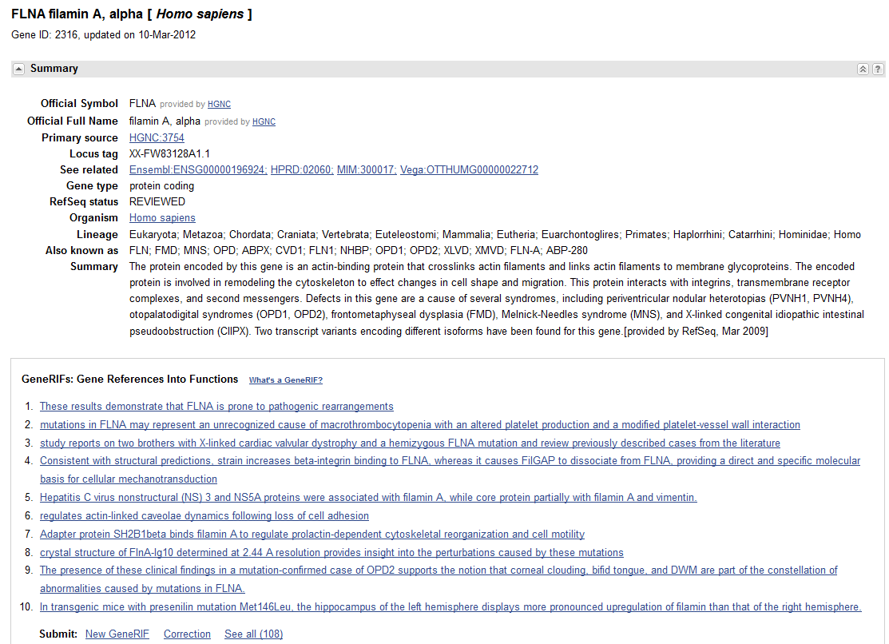
Notes:
When an indexer is indexing a paper, if that paper is focused on a gene or gene product, they create what’s called a GeneRIF. You can see some examples of geneRIFs here. We’re looking at a record in the NCBI Gene database for (click) Filamin A alpha. (click) If you scroll down to the middle of the record, you find a section containing the geneRIFs for that gene. (click) A geneRIF is a link in an Entrez Gene record back to the original paper, with a short annotation summarizing the paper’s findings about that gene or protein. Usually that annotation is something derived from the abstract.
So to make these, the indexer has to manually match the genes in the paper to the Entrez Gene record, make that link, and create an annotation. This process is labor intensive and expensive—about $4.90 per article.

Slide 69
The Gene Indexing Assistant
An automated tool to assist the indexer in identifying and creating GeneRIFs
  Evaluate the article
  Identify genes
  Make links to Entrez Gene
  Suggest geneRIF annotation
Anticipated Benefits:
  Increase in speed
  Increase in comprehensiveness
Notes:
We have developed a production tool for partially automating gene indexing through both in house development and leveraging existing software. We call this tool the Gene Indexing Assistant or the G.I.A. The GIA will perform many of the tasks manually conducted by indexers:
-evaluate whether an article is likely to be suitable for gene indexing AND
-identify genes in the article.
-It will then create links based on those genes to the correct Entrez Gene records, AND
Hopefully eventually suggest candidate sentences for GeneRIF annotations.
-The indexer will then decide whether to keep, discard, or modify the links and suggestions.
When we text this tool with indexers this month, we hope to see gains in speed of indexing and the number of articles that receive gene indexing.

Slide 70
Corpus Creation
Gene mentions
  tagged by manually correcting the automated program
GeneRIF classes
  Non-geneRIF, Structure, Function, Expression, Isolation, Reference, and Other
Claims classes
  Putative, Established, or Non-claim
Discourse classes
  Title, Background, Purpose, Methods, Results, Conclusions
  Alternate dataset of 600,000 structured abstracts with similar labels
Notes:
For this project, we created a corpus for machine learning and evaluation. The corpus consists of 351 recent MEDLINE abstracts from journals on human genetics.
All sentences were run through our earliest gene identification module to tag the gene mentions, which were then manually corrected by hand. This is significantly faster than tagging de novo.
Sentences were tagged with 3 different types of classes that we hoped could help identify geneRIFs through machine learning: geneRIFs, claims, and discourse. For discourse, we also used a non-annotated dataset of structured abstracts, using the structured abstract labels as discourse classes.

Slide 71
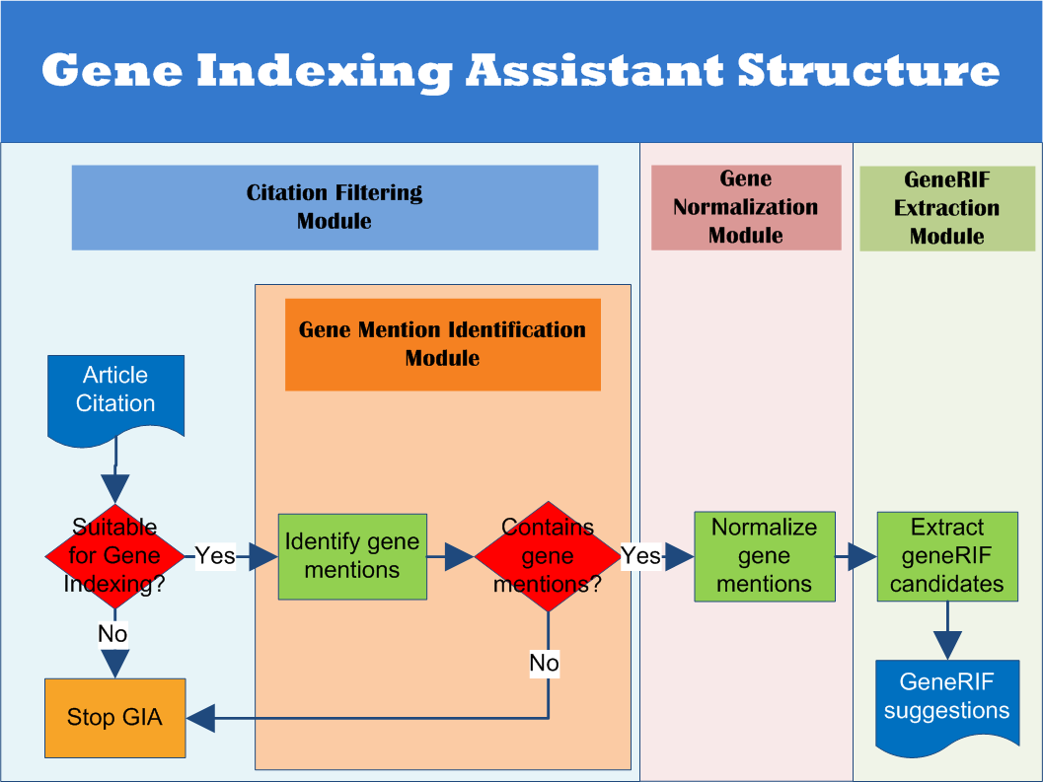
Identify species
Notes:
For the GIA itself, we used rapid prototyping to develop a modular end-to-end application, and then iteratively improved the modules. This diagram represents the four basic modules in the GIA.
First, the citation filtering module. (click) This is the module takes an article citation as input, (click) and determines if it is suitable for gene indexing based on criteria like publication type.
As part of citation filtering, we also run the gene mention identification module. (click) This module finds the names of genes or proteins in the citation. If the citation doesn’t contain any gene mentions, it gets filtered out. If it does contain mentions, we take those mentions and go on to the next module. (click)
This is gene mention normalization. This module tries to match each gene mention back to the correct Entrez Gene record. Each gene must be associated with the correct species to perform this step, so this process includes identifying the species mentioned in the article.
The last module is geneRIF extraction (click). This module figures out the best sentences in the citation to suggest as GeneRIFs. The final product of this process is a list of geneRIF suggestions, linked to the correct Entrez Gene records. (click)

Slide 72
Software Origins
Integrated External Software
GNAT from Jorg Hakenberg
  Include BANNER for gene identification
Linnaeus from Gerner, Nenadic, and Bergman
Organism Tagger from Naderi et al.
Components Developed In-house
Framework
Hand-curated dictionary
In-house modules for human gene identification, normalization, and geneRIF extraction
Notes:
This project is the beneficiary of a great deal of research and development that has been done in biomedical named entity recognition in the last decade, especially in challenges sponsored by NLM, such as BioCreative and TREC. We reviewed existing programs and research, and selected some of the best performing software for identifying and normalizing genes and species to integrate into our system. GNAT, from the lab of Jorg Haakenberg, is high performing open-source software for identifying and normalizing gene names across multiple species. Interestingly, it actually employs another open-source program for it’s identification component, BANNER. So you can see that building these tools is a cumulative effort. We also employ Linnaeus and Organism Tagger for species identification.
In house, we developed the modular program framework, a hand-curated dictionary of gene names, additional simple modules for human gene identification and normalization, and a module for extracting the geneRIF sentences.
Our goal is to have several modules contributing to identification and normalization with a voting mechanism to decide between their results. Previous research has shown that combinations of multiple tools this way outperform even the best performing individual tools.

Slide 73
Identify species
Notes:
AND NOW: I’m going to describe each module as it exists currently, and our plans to continue improving it. (click) In the interest of time, lets skip citation filtering, which is fairly rudimentary and start with the gene identification module.

Slide 74
Gene Mention Identification
Filamin a mediates HGF/c-MET signaling in tumor cell migration.
Deregulated hepatocyte growth factor (HGF)/c-MET axis has been correlated with poor clinical outcome and drug resistance in many human cancers. In our study, we show that multiple human cancer tissues and cells express filamin A (FLNA), a large cytoskeletal actin-binding protein, and expression of c-MET is significantly reduced in human tumor cells deficient for FLNA.
Notes:
The gene mention identification module goes through a title and abstract and picks out any words or phrases that explicitly refer to genes or gene products, like this (click).

Slide 75
Gene Mention Identification
Filamin a mediates HGF/c-MET signaling in tumor cell migration.
Deregulated hepatocyte growth factor (HGF)/c-MET axis has been correlated with poor clinical outcome and drug resistance in many human cancers. In our study, we show that multiple human cancer tissues and cells express filamin A (FLNA), a large cytoskeletal actin-binding protein, and expression of c-MET is significantly reduced in human tumor cells deficient for FLNA.
filamin a, flna, hepatocycte growth factor, c-met
Notes:
The list of gene mentions we would ultimately derive from this example is these four (click.)

Slide 76
Gene Mention Identification
In-House Components
  Hand curated dictionary
    Derived from Entrez Gene
    Filtering for problem synonyms
    Variant creation (reductive tokenization?)
  Strict Dictionary Mapping
    External Components
  GNAT: Conditional Random Fields (CRF) from BANNER
Notes:
We use two main approaches for identifying genes in text. The first is a simple dictionary match that we created in house. We have a hand-curated dictionary is derived from Entrez Gene names and synonyms. We filtered this list for certain problematic names likely to cause many false positives, like synonyms ending in the word “disease” or “syndrome.” We then created orthographic variants for each term.
The second approach is the most popular approach in machine-learning methods for named entity recognition, called conditional random fields, or CRF. CRF tries to identify whether a word is a gene based on machine-derived context rules. GNAT has a CRF identifier trained to recognize genes.

Slide 77
Identify species
Identify species
Notes:
If there are genes mentioned in the citation and the citation passes the filter, we take those mentions and go on to the next step, which is Gene Mention Normalization. In this step, we take the gene mentions the gene identification module found, and we try to find an Entrez Gene ID for each one.

Slide 78
Species Identification and Assignment
External Components
Identification
  Linnaeus: includes common names and maps stand alone genera to most likely species
  Organism Tagger: includes cell lines and microbial strains
Assigning genes to species
  GNAT: Proximity heuristic
Notes:
First, these gene mentions must be assigned to specific species. Our in house system currently handles only human genes, so we do not have an in-house method for this.
We do have two open-source species identifiers from external sources working in tandem, Linnaeus and Organism Tagger. GNAT assigns genes to species based on a proximity heuristic. The essence of the decision is how close to the gene the species name occurs.

Slide 79
Gene Mention Normalization
c-met
ID: 4233, MET
ID: 3082, HGF
hepatocyte growth factor
Official Name
cell migration, cytokine, tumor
ID: 4233, MET
Cancer, tumor, cytokine, cell migration
Synonym
Oncogene, renal, cancer, tyrosine
Notes:
Then genes must be normalized to a specific Entrez Gene ID. Normalization is difficult, because gene naming is highly ambiguous even within single species.
Since our dictionary is built from Entrez Gene, all of our dictionary terms are linked back to their originating Entrez Gene records. If we find a mention at all, that means we have also found at least one Entrez Gene ID. When we have only one possible Entrez Gene ID, our job is simple. (click) Here, C-met is normalized to the only possible option: MET
In the case of ambiguous terms, we have a list of all the matching Entrez Gene IDs. (click) So here we have a gene name, hepatocyte growth factor, that could refer to either of these two different genes. We have created in house two fairly simple disambiguation strategies for these ambiguous mentions.
The first is an “officialness” heuristic: We determine whether the match is an official name/official abbreviation, versus a lesser-used type of synonym. (click) Here “hepatocyte growth factor” is the official name of HGF, but simply a synonym of MET, so HGF would be preferred.
The second method uses what we call gene profiles. A gene profile is collection of keywords extracted from an Entrez Gene record. (click) We can compare those keywords to words in the abstract we’re looking at. (click). Greater similarity gives us a better match. Here again, HGF would be the winner. This is similar to the word sense disambiguation used in areas of the indexing initiative.
The external software GNAT uses similar methodology to what we have developed. They employ string similarity measurements for finding candidate matches, and then a gene-profiles method for normalization.

Slide 80
Gene Mention Normalization
Identification and Normalization Results
Species | Recall | Precision | F₁
Human | 83% | 80% | 81%
Notes:
Interestingly, our two in-house methods generate nearly equal performance. They don’t act identically on individual genes, but their overall performance was comparable in our test set. Using either system, we can correctly identify and assign an Entrez Gene ID to about 81% of human genes in citations.
GNAT performance?
While we do plan to try integrating the results from GNAT and our in-house software, we’re very pleased with the current performance. We expect this level of accuracy to be adequate to substantially reduce the amount of time it takes to perform gene indexing. This part of the system is currently in production testing with indexers.

Slide 81
Identify species
Notes:
The final module of the system, geneRIF extraction, is not production ready. This module should find geneRIF candidate sentences for each normalized mention. We currently have moderate success for identifying sentences that contain novel information about genes, but poor performance when we try to narrow those sentences down to the best possible candidates.

Slide 82
Classifier Results
Features | Precision | Recall | F₁
Position (pos) | 72% | 73% | 72%
Text (word features) | 63% | 64% | 63%
Gene Names | 55% | 70% | 62%
Discourse (Structured Ab. Labels) | 70% | 80% | 75%
pos + discourse | 70% | 86% | 76.89%
pos + discourse + GO | 70% | 86% | 77.07%
Notes:
This chart shows the some of our current test results using various features and combinations of features. (click) Our best results for geneRIF-type sentence classification at the moment are 70% precision and 86% recall, for an F-measure of 77%, on an Ada-boost classifier. This is actually equivalent to human performance on this task.
Unfortunately, these results might contain 5 or more candidate sentences per article. We need a maximum of three to suggest to the indexer. So far, our attempts to narrow these sentences down to the best possible choices have been unsuccessful, with f-measures in the twenties and thirties.

Slide 83
Future Improvements and Research Areas
Additional preprocessing
  Expand certain anaphora
Extracting interaction data
Expanding the dictionaries
Improved abbreviation resolution
Additional training for low-performing species
Integration of additional identification or normalization software
Notes:
This emphasizes the need for us to change tacks and explore additional ways to get to the point of the annotation: how can we find and summarize the main points of an article about genes?
One thing we are exploring is preprocessing of the sentences. We plan to try some relatively simple anaphora resolution. Anaphora means referring to a concept by only using part of its name or a substitute name like a pronoun. Resolving some of this as it relates to diseases and genes, for example, would probably help us recognize geneRIF sentences better. Easy targets are phrases like “this gene” or “patients” or “affected families.”
An obvious related research area is extracting relationship or interaction data. I’m planning to work on this with Tom Rindflesh’s lab this summer.
Some other planned improvements are expansions and improvements to our dictionaries, especially with identifiers from other gene and protien databases like UniProt. We’re looking into some improved abbreviation resolution with Francois for non-local abbreviations. We may pursue additional training for gene identification for species that are underperforming, like rats. And finally, we may incorporate additional identification or normalization software.

Slide 84
Research and Outreach Efforts (concl.)
External Collaboration
  IBM DeepQA group: applying Watson to health care
Data Dissemination
  MEDLINE Baseline Repository
  WSD test collections
Biomedical NLP/IR Challenges
  Text Retrieval Conference (TREC)
    Genomics track
    Medical Records track
  Informatics for Integrating Biology & the Bedside (i2b2)
  Medical NLP Challenge
Tomorrow …
LHNCBC Participation in NLP/IR Challenges

Slide 85
Outline
Introduction [Lan]
MetaMap [François]
The NLM Medical Text Indexer (MTI) [Jim]
Availability of Indexing Initiative Tools [Willie]
Research and Outreach Efforts [Antonio, Caitlin, Lan]
Summary and Future Plans [Lan]
Questions

Slide 86
Indexing Initiative Top 10 (1/2)
10. ‘MTI Why’ explanation facility
9. Application of MTI to Cataloging and History of
Medicine records
8. The MetaMap UIMA wrapper, increasing MetaMap’s availability
7. Significant speedup of MetaMap
6. Collaboration with IBM DeepQA group applying Watson to health care

Slide 87

Indexing Initiative Top 10 (2/2)
5. The development of Gene Indexing Assistant (GIA)
4. More WSD methods with better results
3. Improvement in MTI’s performance due to technical enhancements and close collaboration with Index Section
2. Downloadable releases of MetaMap, especially for Windows
Inauguration of MTI as a first-line indexer (MTIFL)!

Slide 88
Future Plans
Continued collaboration with
  The NLM Index Section
  IBM and other external organizations
Planned improvements to MetaMap and MTI such as
  Expansion/improvement of MTIFL capability
  Add species detection to MTI for disambiguation and for GIA
  Further MTI research with Antonio Jimeno-Yepes and Caitlin Sticco
  Possible high-level MetaMap modularization to facilitate plug and play strategies

Slide 89
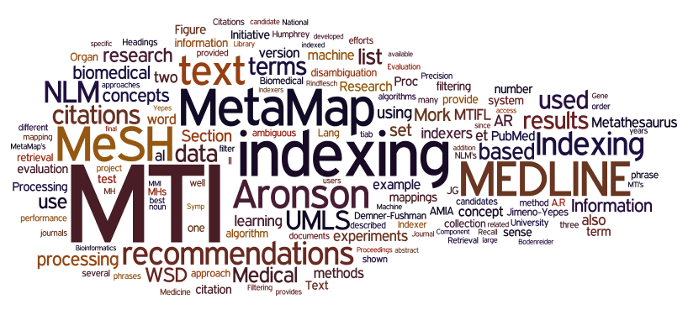
Questions
Generated using Wordle™ (www.wordle.net)
Alan (Lan) R. Aronson Willie J. Rogers
James G. Mork Antonio J. Jimeno-Yepes
François-Michel Lang J. Caitlin Sticco

Slide 90
Extra slides in case of questions

Slide 91
Candidate Pruning: Output Example
protein-4 FN3 fibronectin type III domain GSH glutathione GST glutathione S-transferase hIL-6 human interleukin-6 HSA human serum albumin IC(50) half-maximal inhibitory concentration Ig immunoglobulin IMAC immobilized metal affinity chromatography K(D) equilibrium constant

Slide 92
Candidate Pruning: Output Example
(Total=99; Excluded=13; Pruned=50; Remaining=36)
783 equilibrium constant [npop]
780 P Equilibrium [orgf]
780 P Kind of quantity - Equilibrium [qnco]
780 P Constant (qualifier) [qlco]
713 protein K [aapp]
691 Protein concentration [lbpr]
671 protein serum [aapp,bacs]
671 Protein.serum [lbtr]
656 P serum K+ [lbpr]
656 protein human [aapp,bacs]
653 Human immunoglobulin [aapp,imft,phsu]

Slide 93
User-Defined Acronyms (UDAs)
Simply create a text file with UDA definitions:
CABG | coronary artery bypass graft
PTCA | percutaneous transluminal coronary angioplasty
RBBB | right bundle branch block
LAFB | left anterior fascicular block
AV | aortic valve
PTLD | post-transplantation lymphoproliferative disorder
CHOP | cyclophosphamide, hydroxydaunomycin, Oncovin, and prednisone
LIMA | left internal mammary artery
LAD | left anterior descending coronary artery
SVG | saphenous vein graft
PLB | posterolateral bundle
PDA | posterior descending artery
IM | internal mammary

Slide 94
Complexity - Composite Phrases
Pain on the left side of the chest
Left sided chest pain (C0541828)
Linguistic variants
Syntactic processing
Word order

Slide 95
10²¹ Terabytes of Memory?!
10²¹ = 10¹⁰ * 10¹¹
= (10 billion) * (100 billion)
Oak Ridge National Lab’s Cray Jaguar: 300TB
150% of world population
Required
terabytes/person

Slide 96
Concepts with at least 300 Synonyms
349: C1163679|Water 1000 MG/ML Injectable
Solution
327: C0874083|Triclosan 3 MG/ML Medicated
Liquid Soap
312: C0980221|Sodium Chloride 0.154 MEQ/ML
Injectable Solution

Slide 97
MSH WSD corpus
MEDLINE
UMLS
MH
Disambiguation corpus
Notes:
The MSH WSD corpus contains ambiguity cases obtained by the overlapping of the UMLS and MEDLINE based on MeSH indexing. We consider the MeSH indexing as the reference for the correct sense of the ambiguous word.

Slide 98
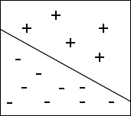
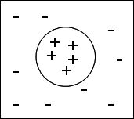
Meta-learning
Notes:
The following image shows the projection of the citations in a two dimensional space. The plus signs indicates that the citation has to be indexed with the MeSH heading while the minus sign indicates that the citation is not indexed with the MeSH heading.
Each image represents two different MeSH headings. We find that on the left side, the examples can be linearly separable, so we could use an SVM with a linear kernel. On the right side, the citations cannot be linearly separable and we would rely on other algorithms like k-NN.

Slide 99
ML: Human MeSH heading
Method | Average F-measure
MTI | 0.72
Naïve Bayes | 0.85
Support vector machine | 0.88
AdaBoostM1 | 0.92
Notes:
The following table shows the result obtained by applying different methods to index the MeSH heading humans.
We find that AdaBoostM1 has the highest F-measure in the different validation sets.
This table could show a different behavior for other MeSH headings, in which MTI could be the method with the highest F-measure.

Slide 100
Accuracy
Accuracy is how close a measured value is to the actual (true) value
Precision, proportion of relevant predictions

Slide 101
Micro/macro averaging
Macro averaging takes into account the category (MH)
Micro averaging does not consider MH
MH | True Pos | False Pos | Positive | Precision | Recall | F-measure
Humans | 66,429 | 5,985 | 71,484 | 0.9174 | 0.9293 | 0.9233
Male | 24,664 | 7,107 | 34,463 | 0.7763 | 0.7157 | 0.7448
Female | 25,824 | 6,718 | 35,501 | 0.7936 | 0.7274 | 0.7590
Macro |  |  |  | 0.8291 | 0.7908 | 0.8090
Micro | 116,917 | 19,810 | 141,448 | 0.8551 | 0.8266 | 0.8406

Slide 102
MetaMap Indexing (MMI)
Summarizes and scores what is found within a citation
Location - Title given more emphasis
Frequency of occurrence
Relevancy:
  MeSH Tree Depth
  MetaMap score
Provides a scored and ordered list of UMLS concepts describing the citation
Provides our best indicator of MeSH Headings
Notes:
Original indexing experiments and precursor to MTI

Slide 103
Restrict to MeSH
Allows us to map UMLS concepts to MeSH Headings
Maps nomenclature to MeSH
Encephalitis Virus, California
ET: Jamestown Canyon virus
ET: Tahyna virus
Inkoo virus
Jerry Slough virus
Keystone virus
Melao virus
San Angelo virus
Serra do Navio virus
Snowshoe hare virus
Trivittatus virus
Lumbo virus
South River virus
California Group Viruses

Slide 104
PubMed Related Citations (PRC)
Uses PubMed pre-calculated related articles, same as DCMS Related Articles tab
Provides terms not available in title/abstract
Used to filter and support MeSH Headings identified by MetaMap Indexing
Only use MeSH Headings, no CheckTags, no Subheadings, no Supplemental Concepts
Can provide non-related terms, so heavily filtered

Slide 105













MTI – Initial MTIFL Journals (Feb 18, 2011)

Slide 106






MTI – Added MTIFL Journals
Added September 5, 2011
Added June 1, 2011
Added August 18, 2011
(17)
(19)

Slide 107



MTI – Added MTIFL Journals
Added October 5, 2011
(23)

Slide 108
MTIFL Journal Performance

Slide 109
Precision, Recall, F-Measure
Recall: 3/10 = 0.3
10 Indexing
15 MTI
3 Matches
Precision: 3/15 = 0.2
F₁-Measure: (2 * 0.2 * 0.3) / (0.2 + 0.3) = 0.24

Slide 110
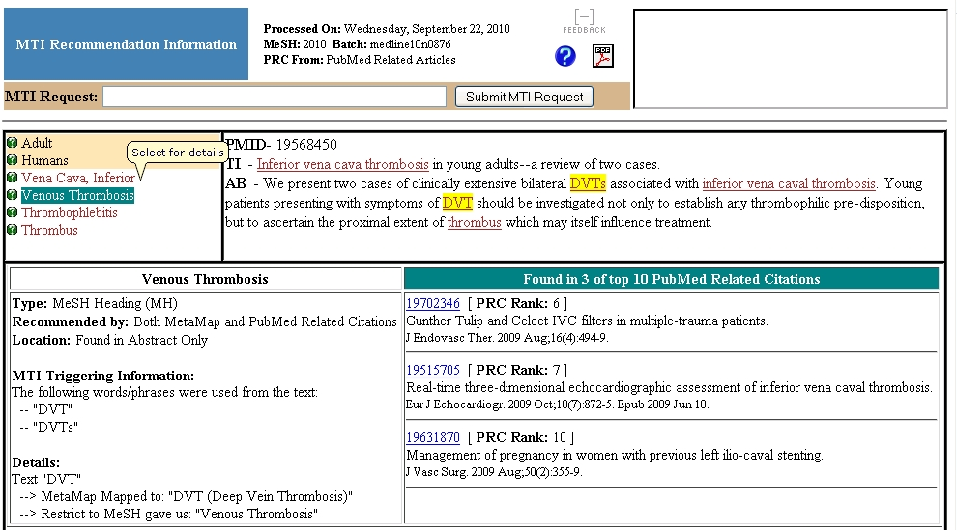
MTIWhy
Received 2,330 Indexer Feedbacks
Incorporated 40% into MTI
March 20, 2012
Why did MTI pick up the term "Crow" in this health services article? This is definitely wrong and needs to be looked into.
Polypeptide aptamer should be indexed as Peptide aptamer (instead of Peptides and Oligonucleotides).

Slide 111
Questions
Alan (Lan) R. Aronson
James G. Mork
François-Michel Lang
Willie J. Rogers
Antonio J. Jimeno-Yepes
J. Caitlin Sticco

